Slide 1
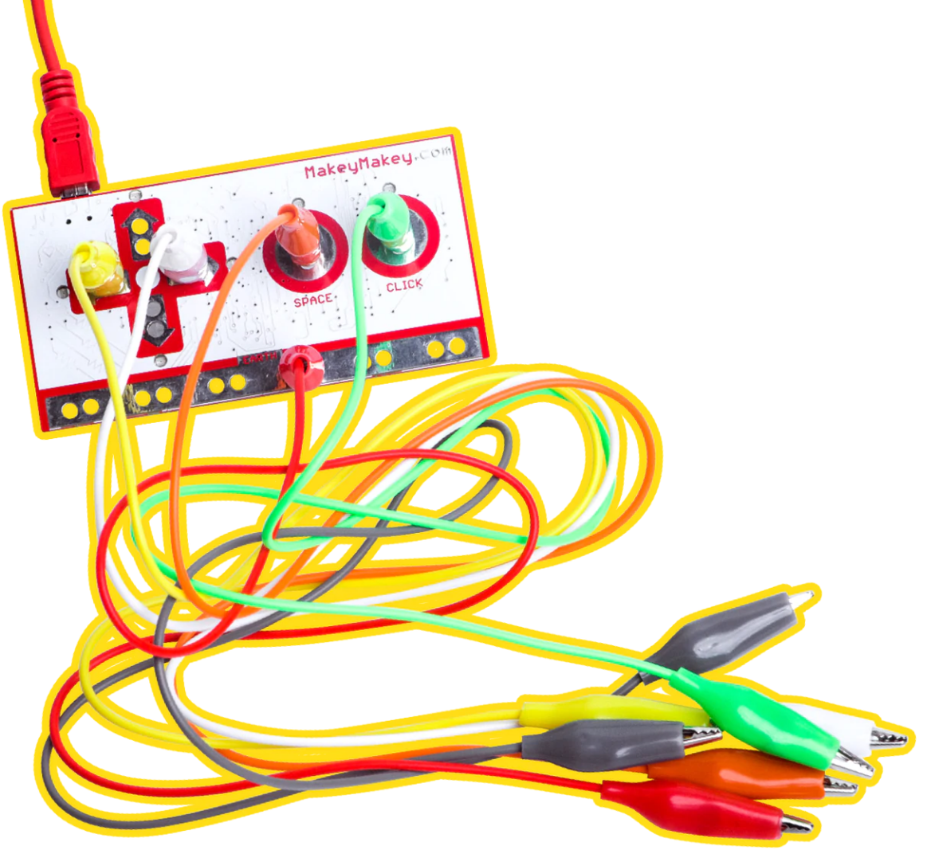
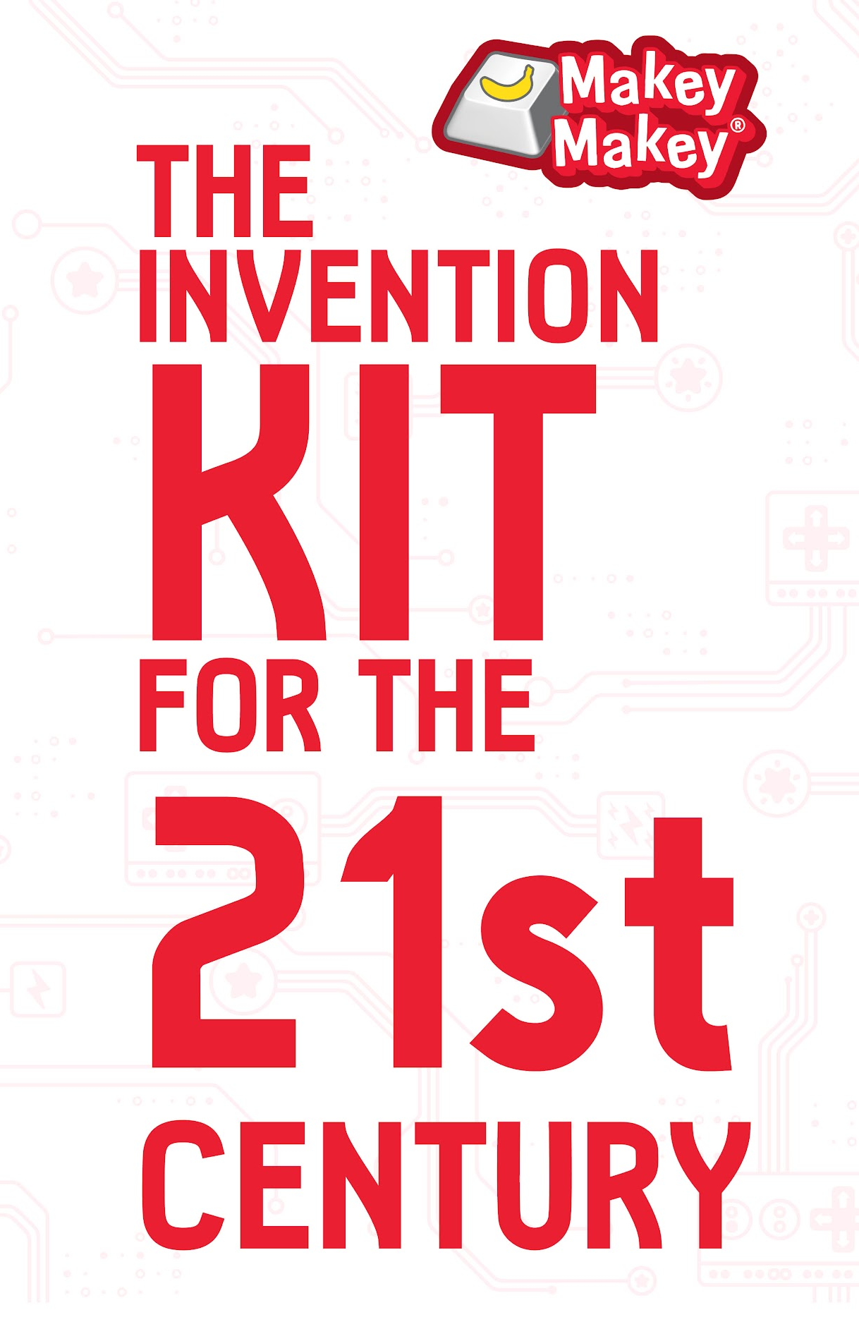
Notes:
Colleen

Slide 2

Makey Makey™ is brought to you by…
an independent research lab founded by Jay Silver that specializes in designing generative and creative platforms that expand human creative potential.

Slide 3
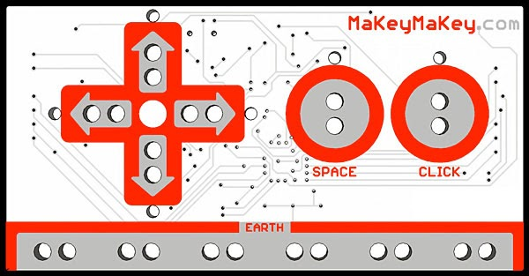
Meet
Makey Makey
Notes:
Colleen
Let’s get started wIth an introduction to the Makey Makey Kit that you have. As we go through, this is also a great time to think about how you would introduce Makey makey to other teachers and students.
10 min: Section 1: What is Makey Makey? Circuit Bridge Metaphor
Objectives:
Learn about the components that come in the Makey Makey Invention kit
Learn how Makey Makey works
Learn how alligator clips extend connections
Understand how Makey Makey works, so you can start building and coding your own inventions

Slide 4
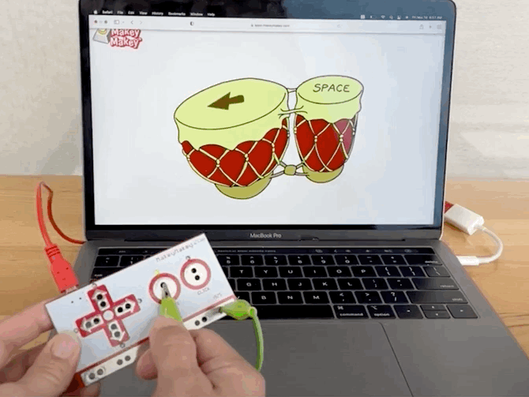
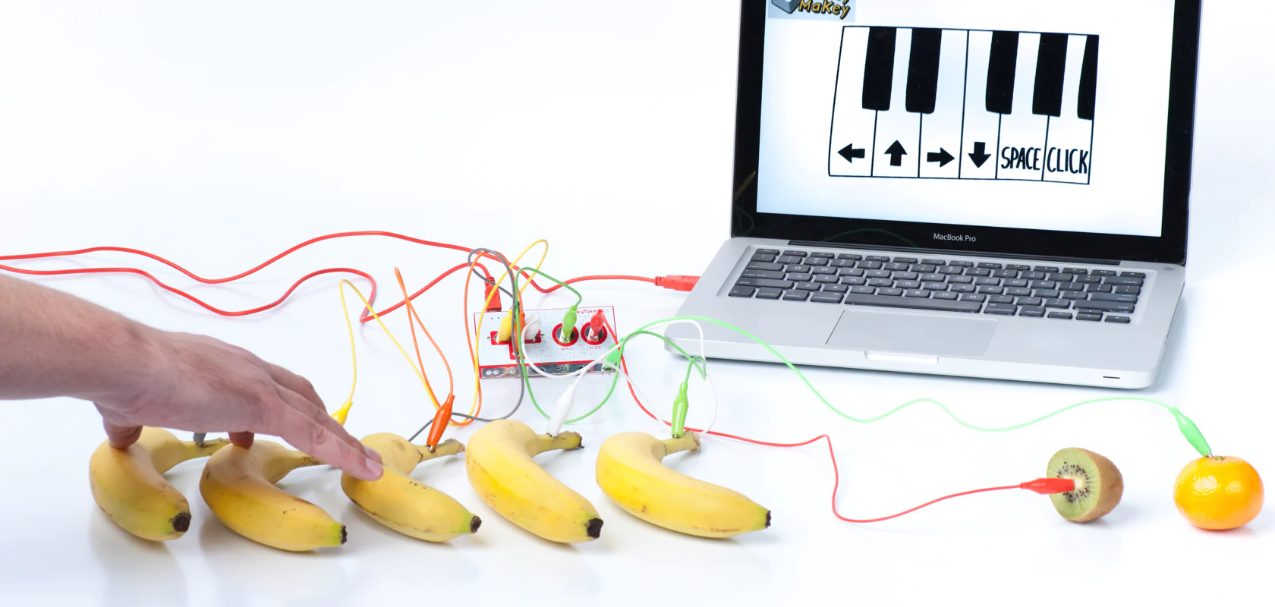
Replaces your Keyboard!

Slide 5
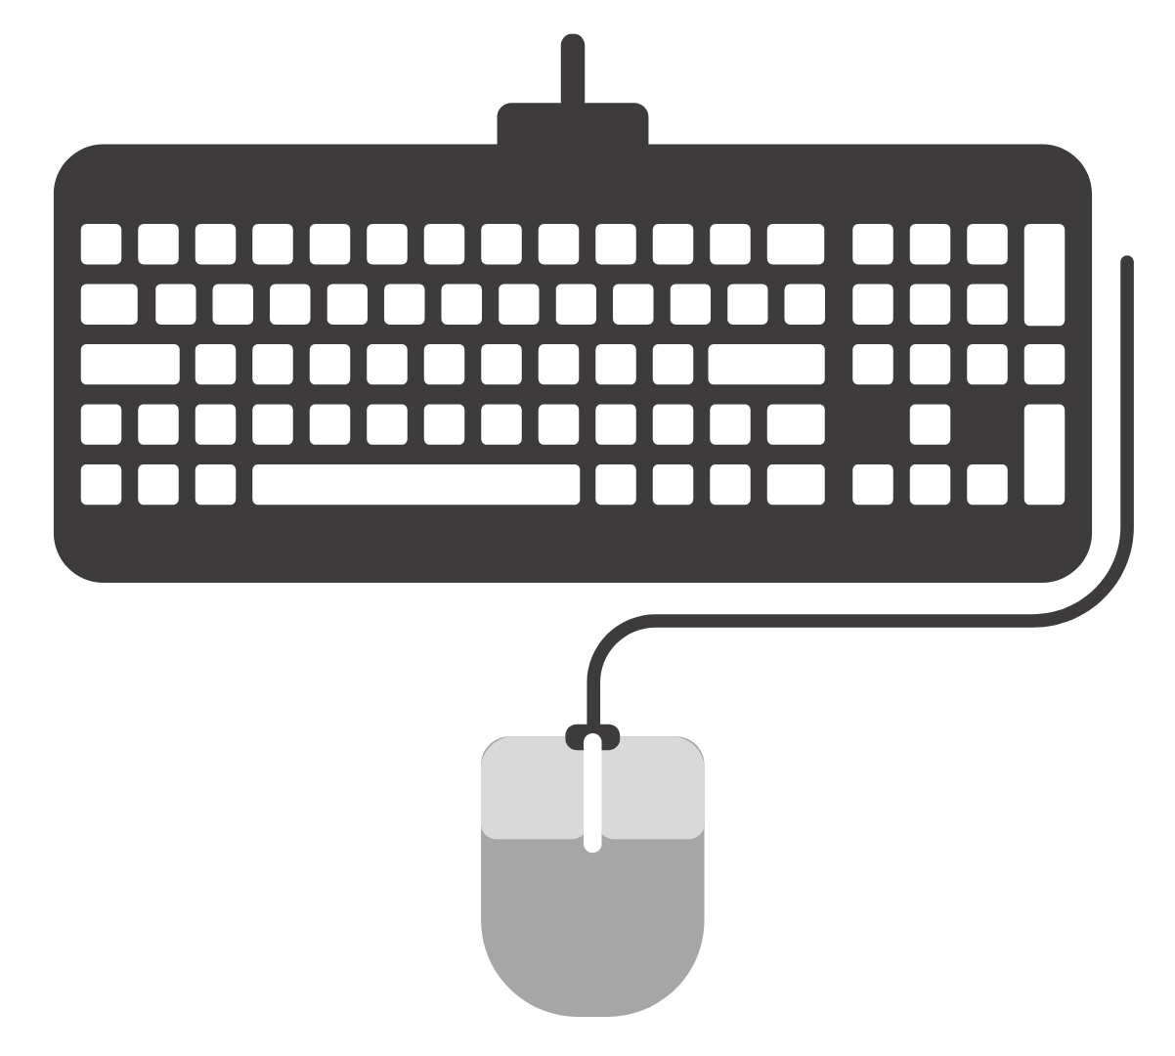
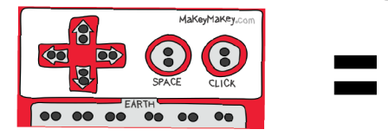
Keyboard Keys & Mouse Clicks
Makey Makey acts like your keyboard or mouse, but you can now control your computer with bananas, drawings, plants, and many other conductive materials.

Slide 6
What is this magic?
Notes:
Colleen

Slide 7

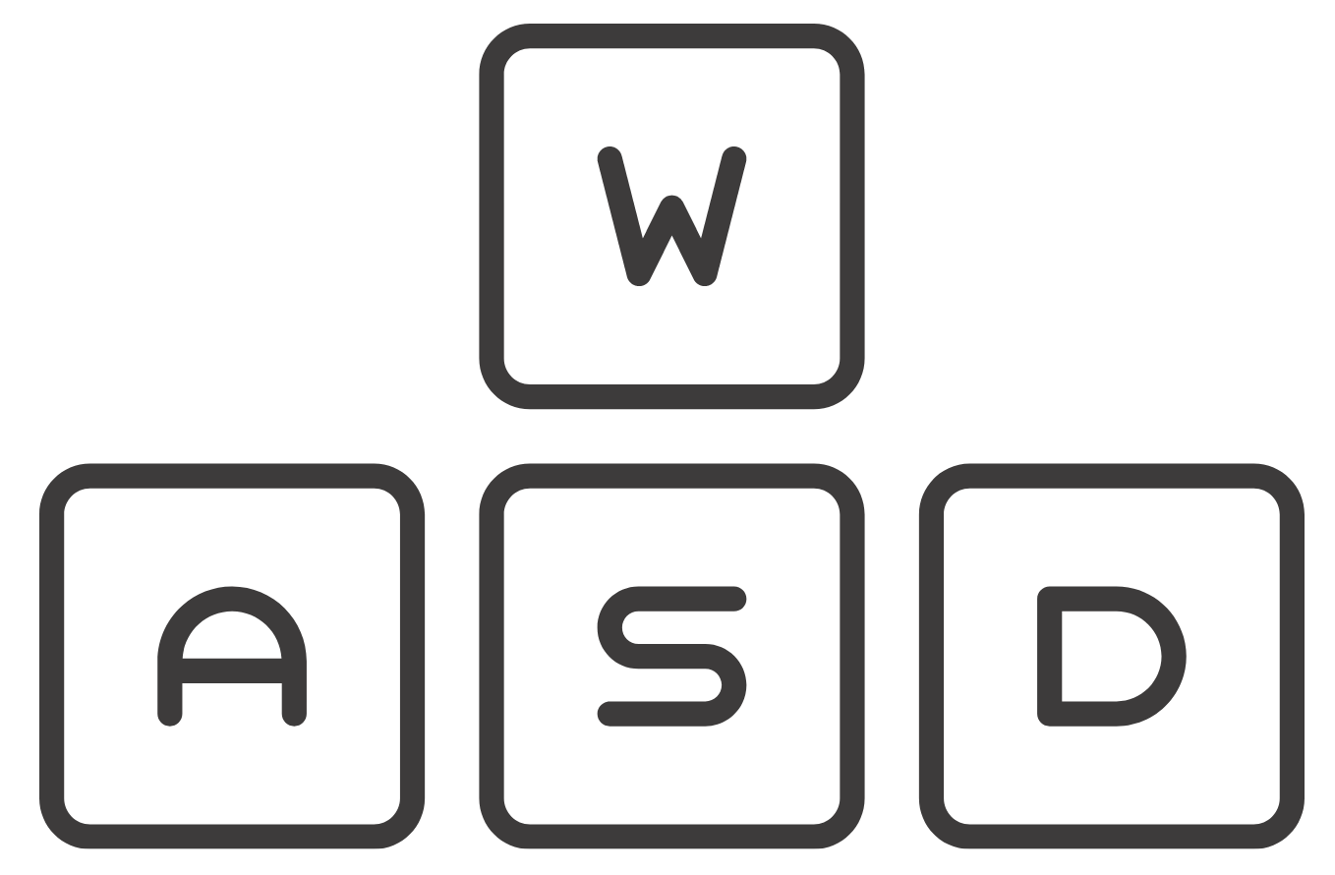
Each “key” is actually a switch.

Slide 8
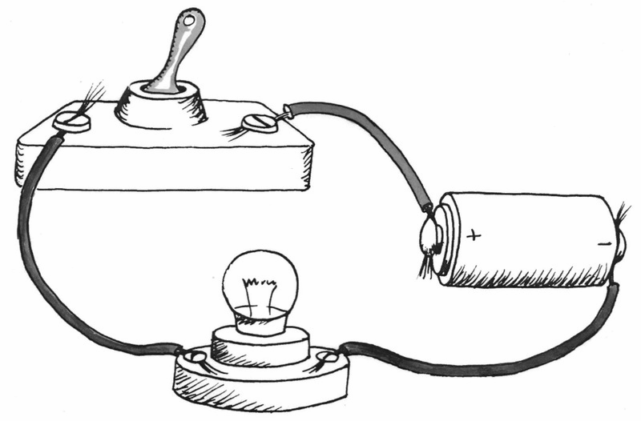
A switch opens and closes a circuit.

Slide 9
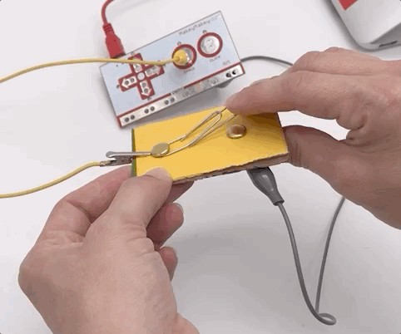
Makey Makey allows you to create your own “switch”.

Slide 10
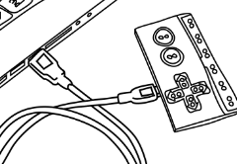
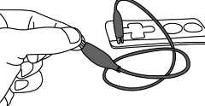
First Time Setup
Plug in USB
The small side of USB cable plugs into Makey Makey, and the big side plugs into your computer.
Connect to EARTH
Connect one end of an alligator clip to "EARTH" on the bottom of the front side of Makey Makey.
Hold the metal part of the other end of the alligator clip between your fingers. You are now "grounded."

Slide 11
Who ♥️s Makey Makey?
Educators who want their students to have super-engaging experiences of learning through active exploration and discovery
Elementary school teachers (sweet spot: 3rd-6th grades)
Secondary school teachers & even High School teachers
STE(A)M Coaches and Coordinators (early adopters)
Educators new to STEM or integrated-STEM subjects
Special Ed Specialists / Occupational Therapists
Teachers in training (teachers colleges, certification programs)
Homeschool Pods & Networks
Parents who want to encourage learning through play

Slide 12
Things to know about Makey Makey
Suitable (and safety tested) for ages 8 to infinity
An entry-level STEM education platform (low floor)
Opens limitless possibilities for hands-on projects (wide walls, high ceiling)
Promotes “Creative Confidence” and engagement in learning
Works with Chromebooks, Windows, Mac OS, Linux, (iPads w adapter)
No software installation, licenses, or subscriptions
Set-up takes seconds in the classroom or directed remotely from home
No coding experience required
Often used with (free) Scratch block-based coding environment

Slide 13
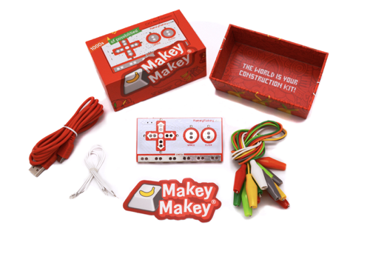
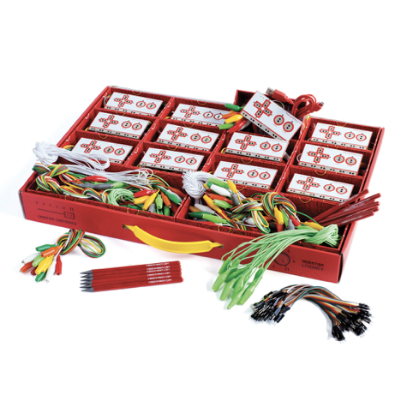
Flagship Products
Makey Makey STEM Pack –
Classroom Invention Literacy Kit
Makey Makey Classic
Notes:
Eli

Slide 14
Makey Makey Classic
Makey Makey circuit board
USB cable
7 alligator clips
6 connector wires
Illustrated instruction guide
Makey Makey sticker
Notes:
Eli

Slide 15
STEM Pack – Classroom Invention Literacy Kit
12 Makey Makey boards
12 USB cables
147 alligator clips
12 extra-long (6ft) alligator clips
144 ruggedized connector wires
12 extra-long (6ft) connector wires
12 illustrated instruction guides
12 conductive graphite pencils
1 printed Educator‘s Guide
Notes:
Eli

Slide 16
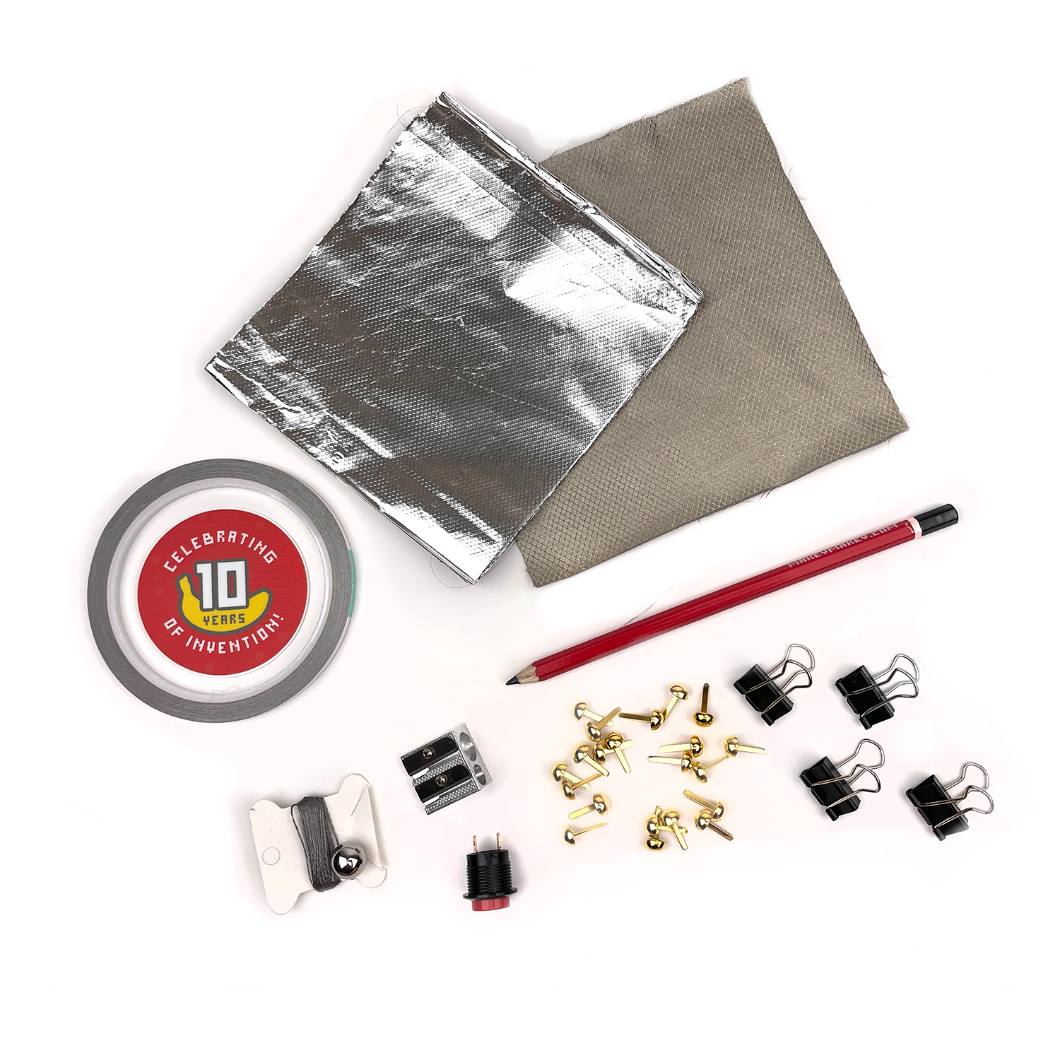
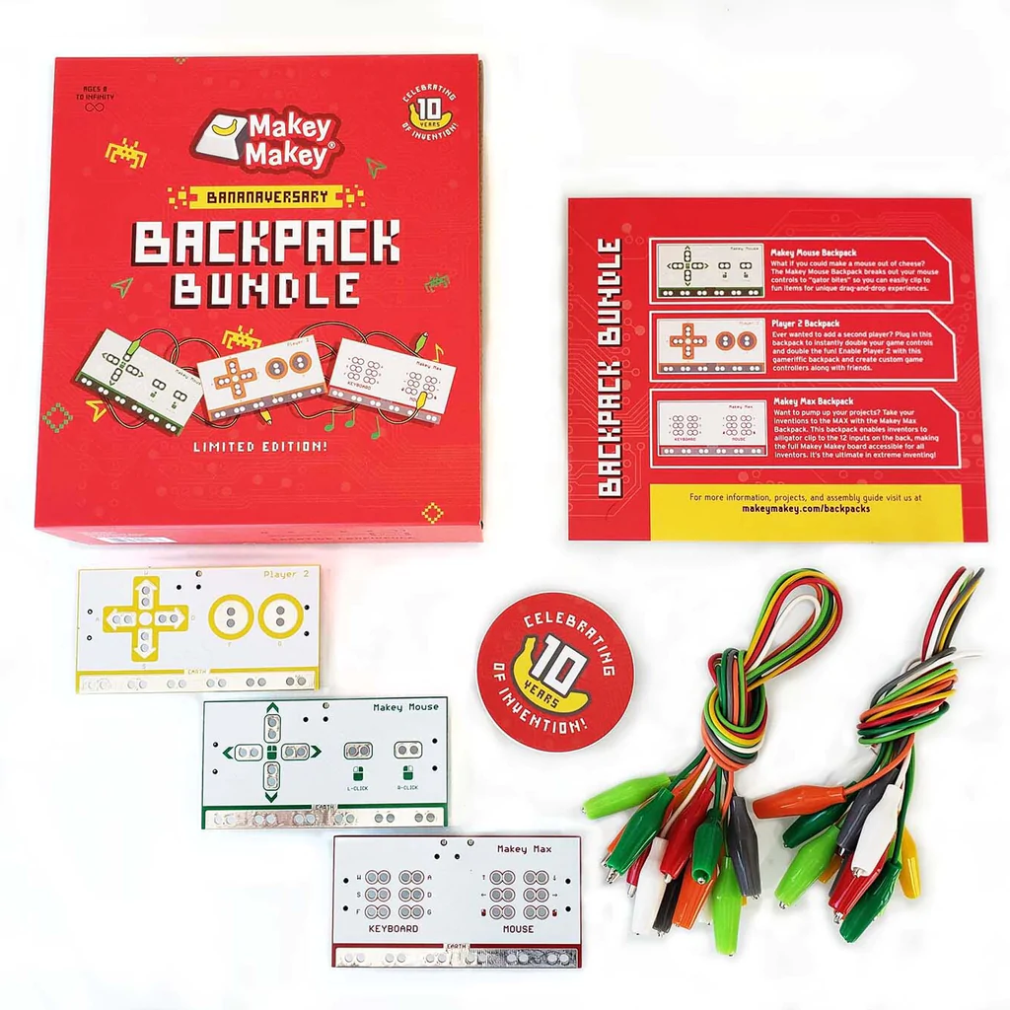
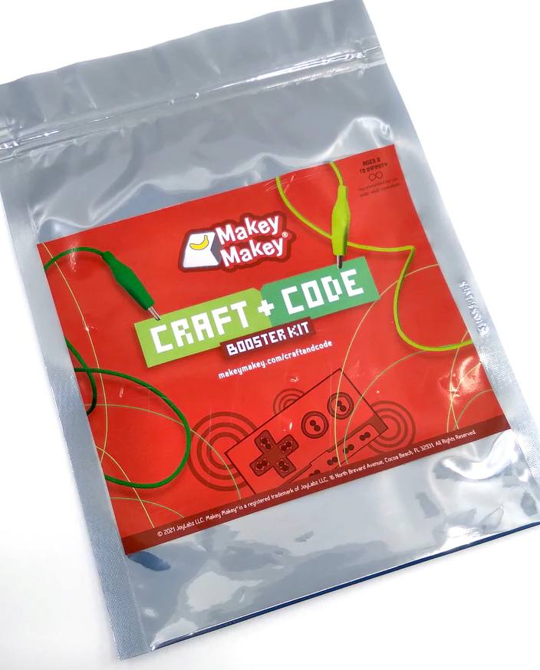
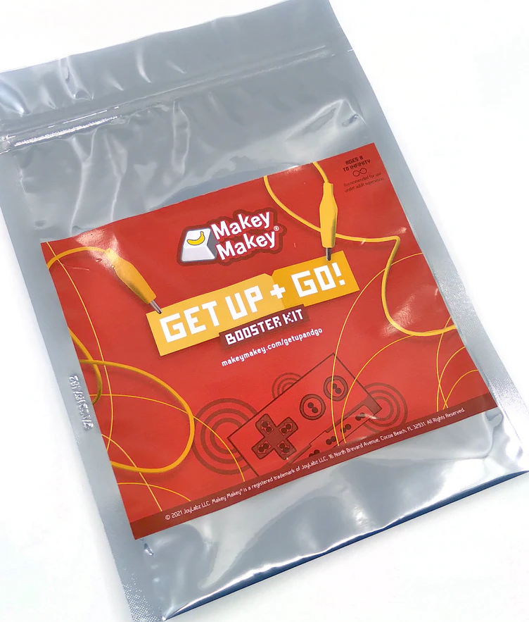
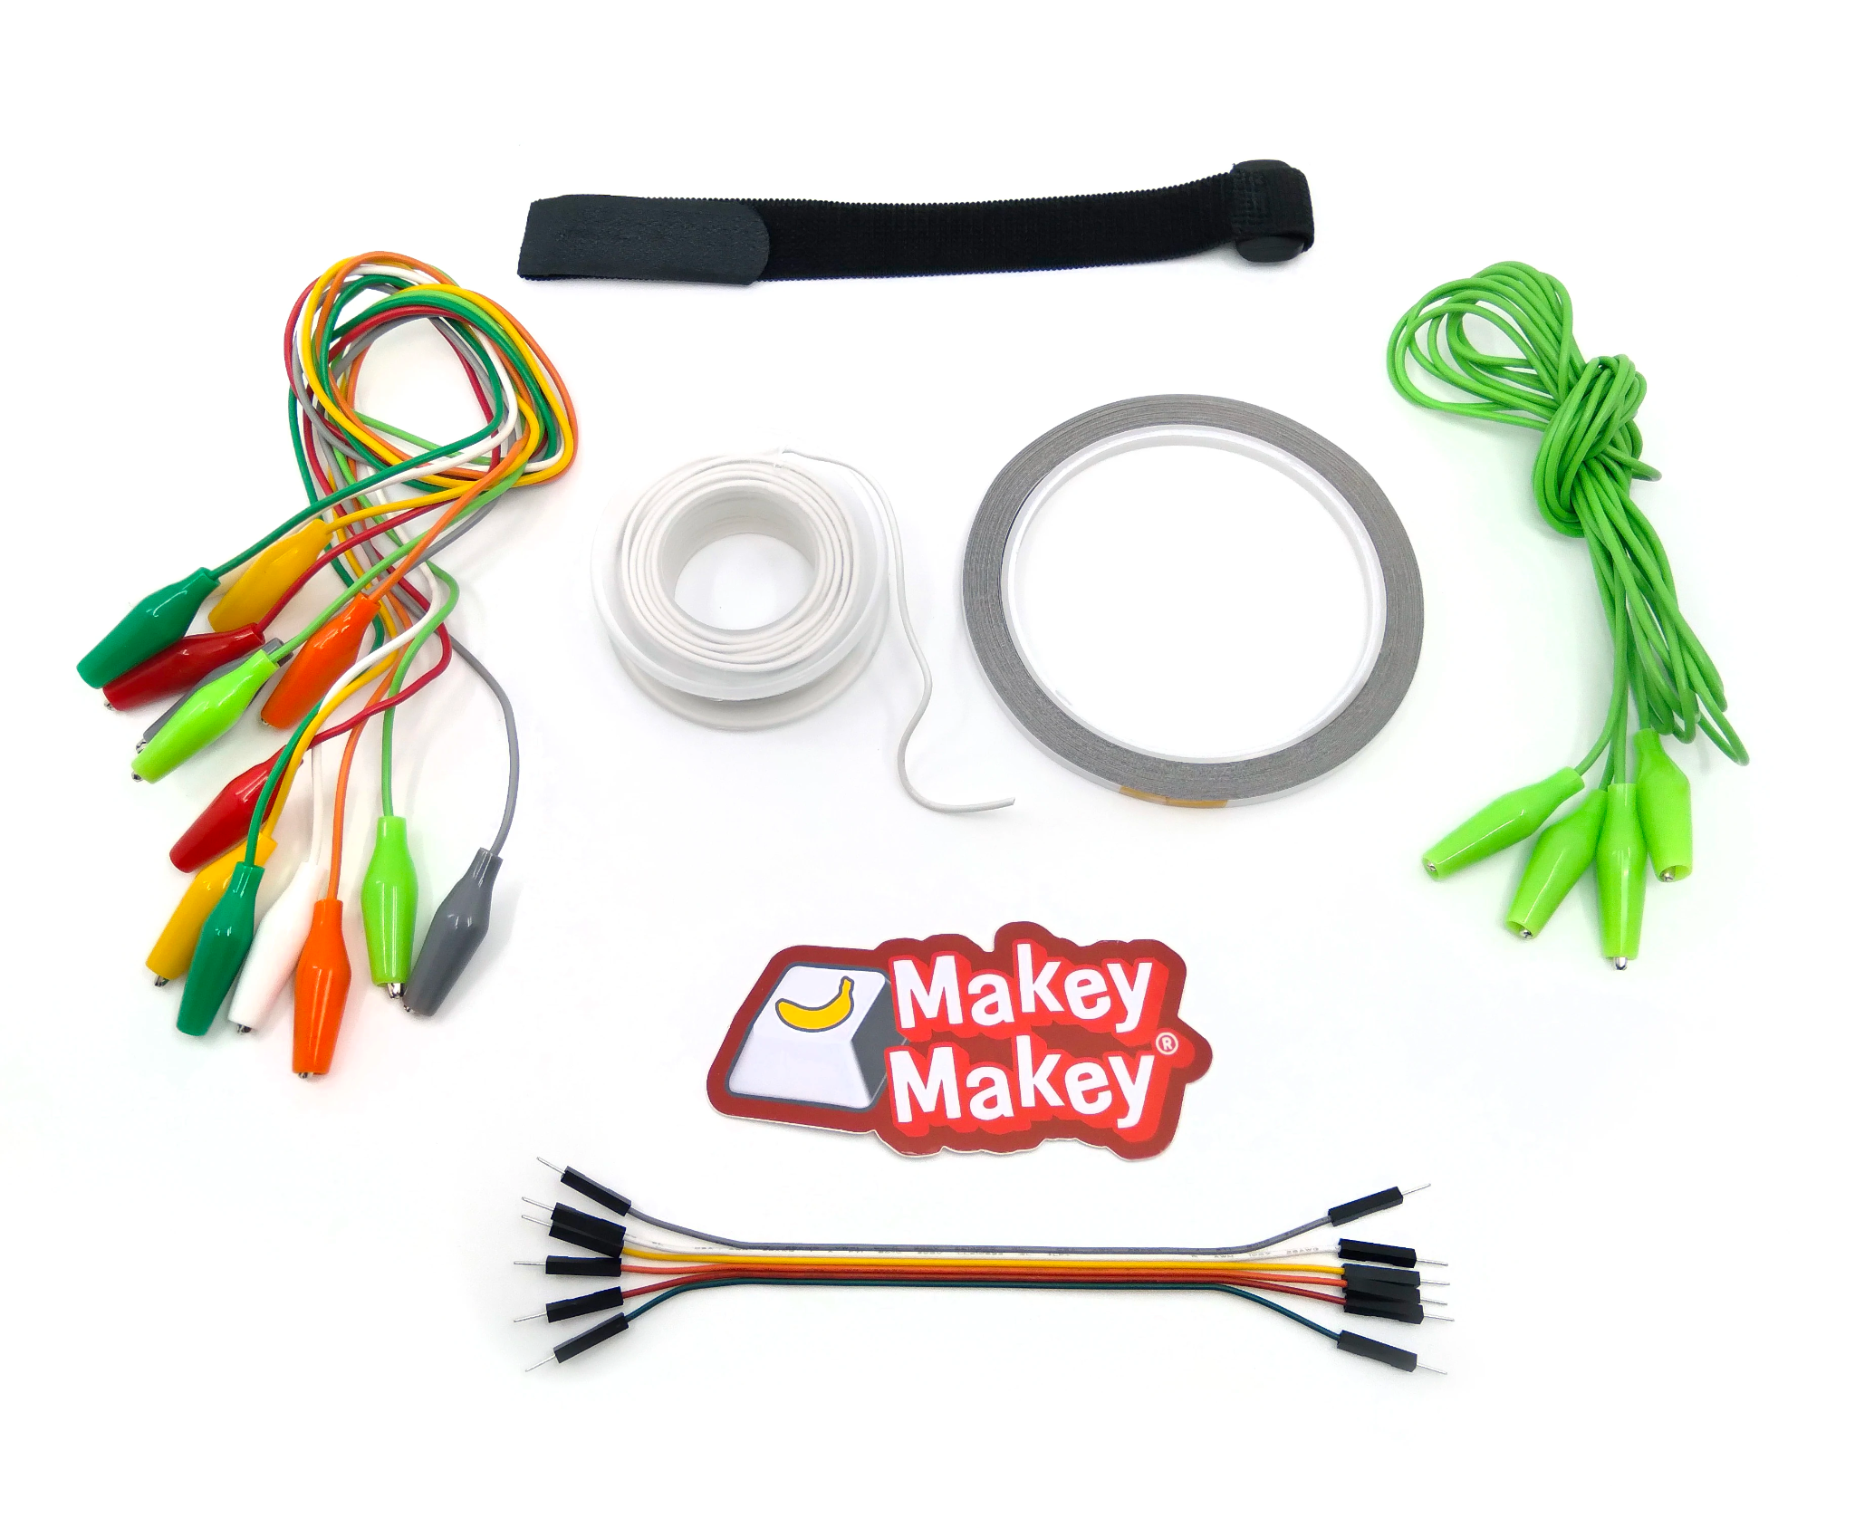
Accessory Products
Booster Kits
Bananaversary Backpack Bundle
Notes:
Colleen

Slide 17
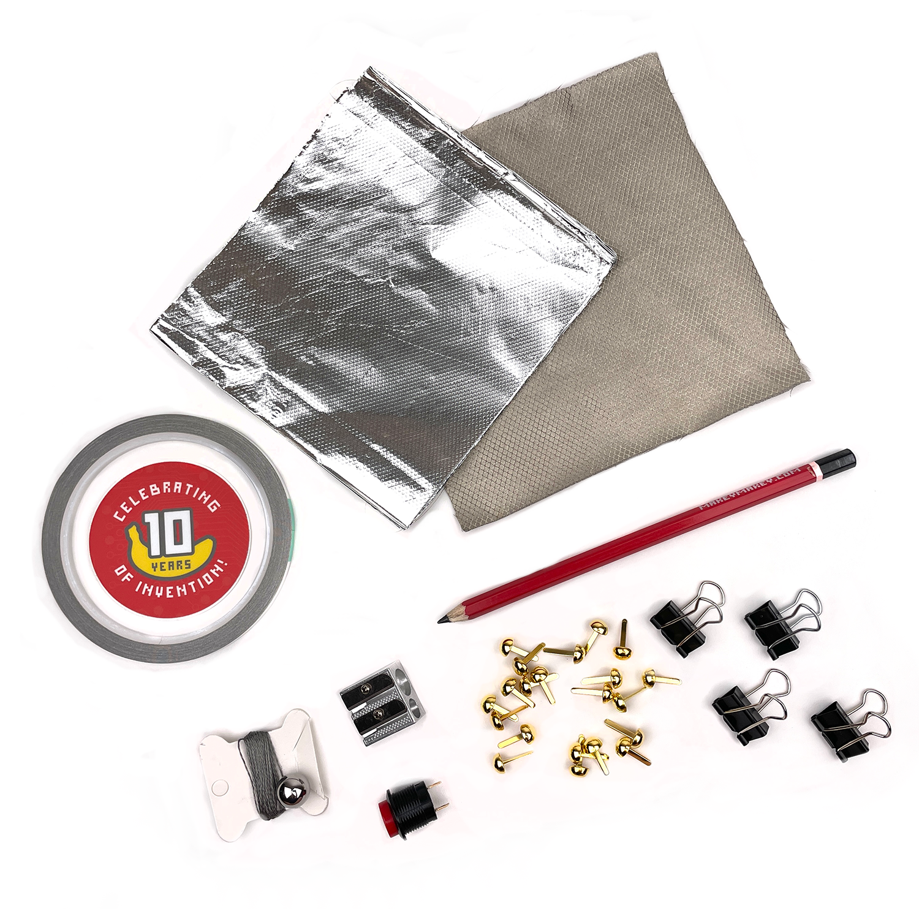
Craft + Code Booster Kit
Notes:
Colleen- This kit is inspired by all of the crafting and inventiveness we’ve seen created by the community over the years. It contains a variety of creative materials such as binder clips and aluminum foil as well as hard to find components such as conductive thread, conductive fabric and some Makey Makey pencils. The goal of this kit is to help with merging art and technology without having to chase down materials.

Slide 18
Get Up + Go! Booster Kit
Notes:
Colleen- The Get Up + Go! Booster kit is inspired by all of the time that we have all spent in front of computers the past few years. How do we get up, move around and use computers in a different way? How do we use computers as a media that we get up and physically interact with? We can use the Makey Makey to build bigger projects, active projects, something that gets us going!
So you will see in this kit extra long alligator clips, spool of wire and more!

Slide 19
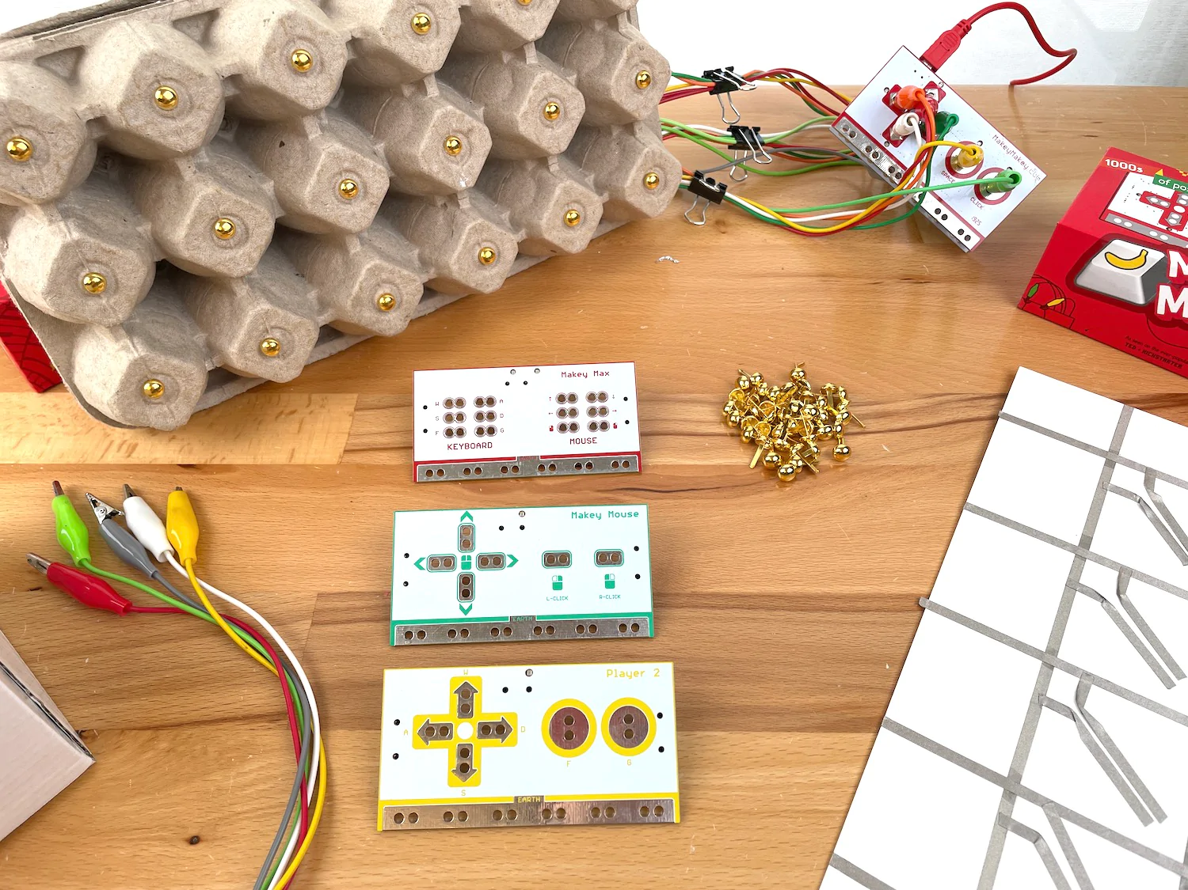
Makey Makey Backpacks
Notes:
Colleen

Slide 20
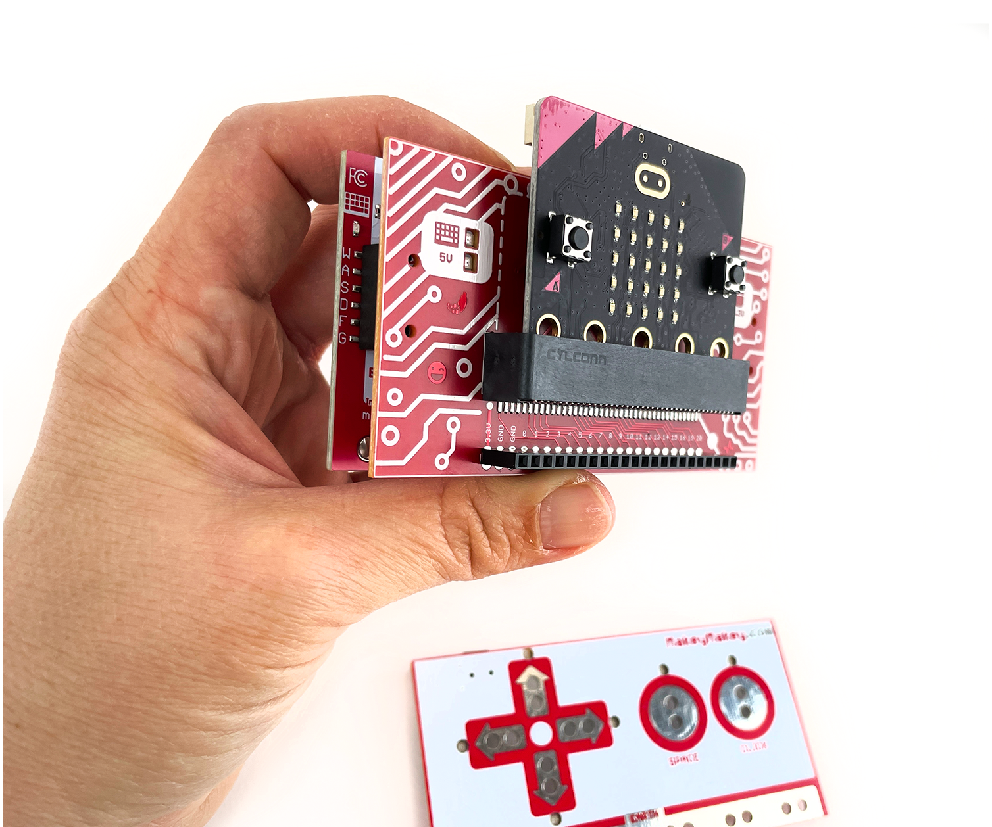
Code-a-Key
Backpack!
Notes:
Eli

Slide 21

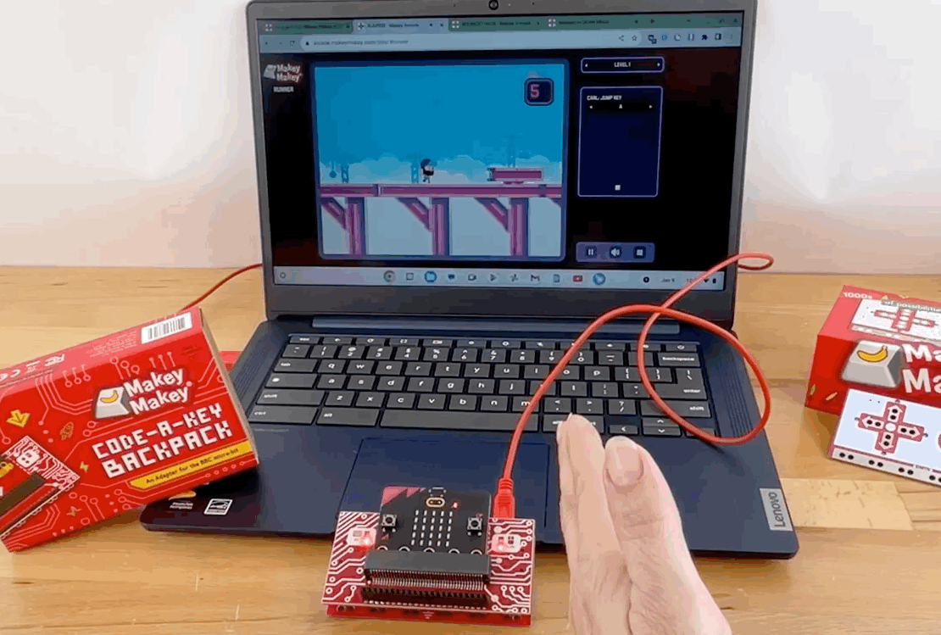
Notes:
Eli

Slide 22
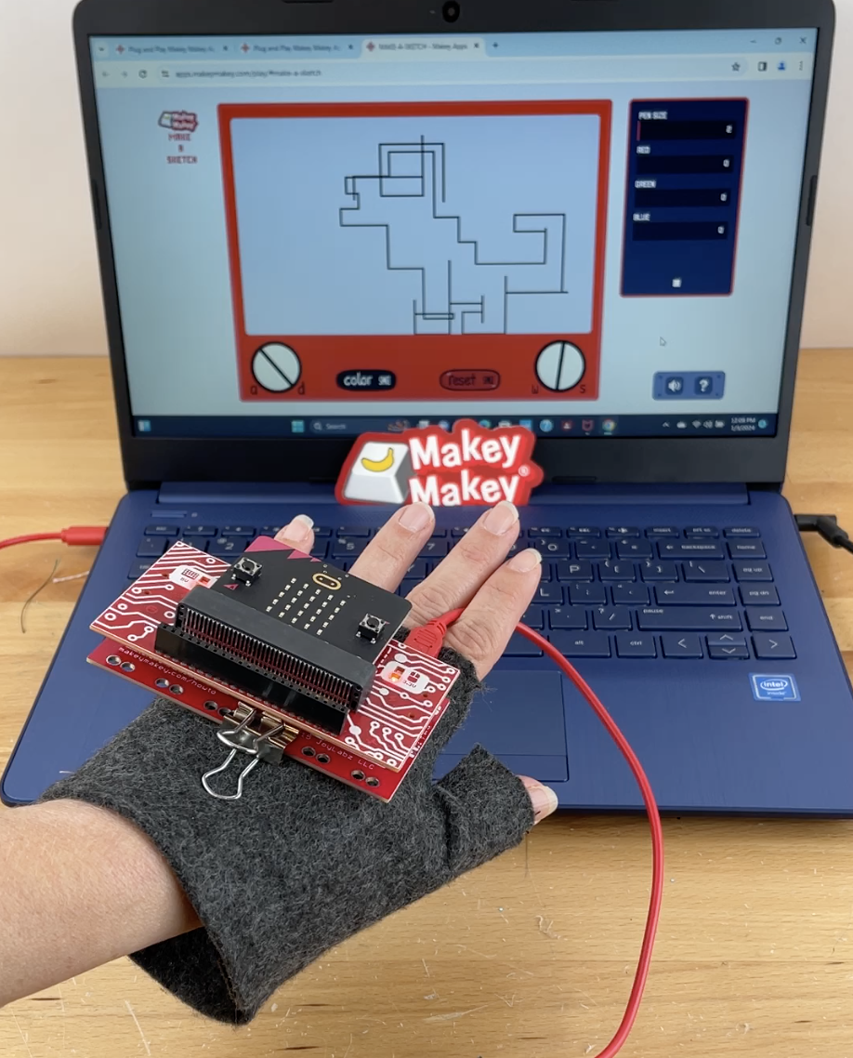
Motion controlled DIY PowerGlove!
Notes:
Eli

Slide 23
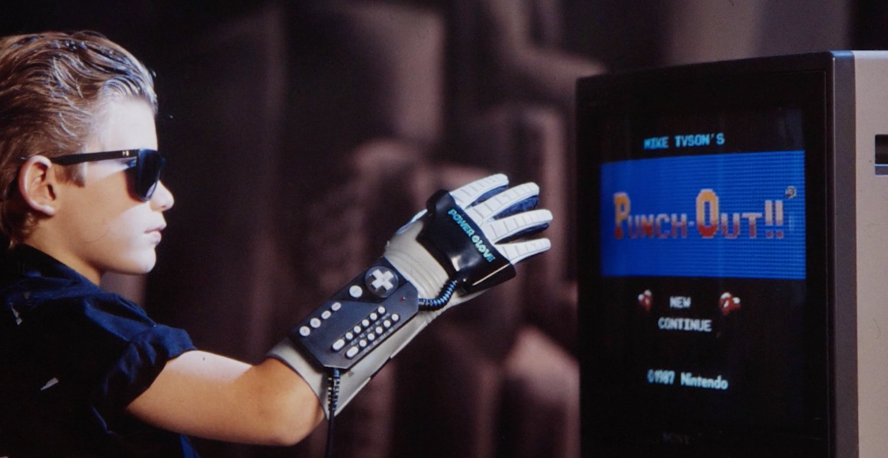
(this is the actual Power Glove)
Notes:
Eli

Slide 24

Plug and Play Apps
Notes:
ANA
We know Colleen introduced you to the basics of Makey Makey this morning. You explored conductivity. We’re going to continue where she left off and we will start by introducing you to some more apps and how you can use these with your students.

Slide 25
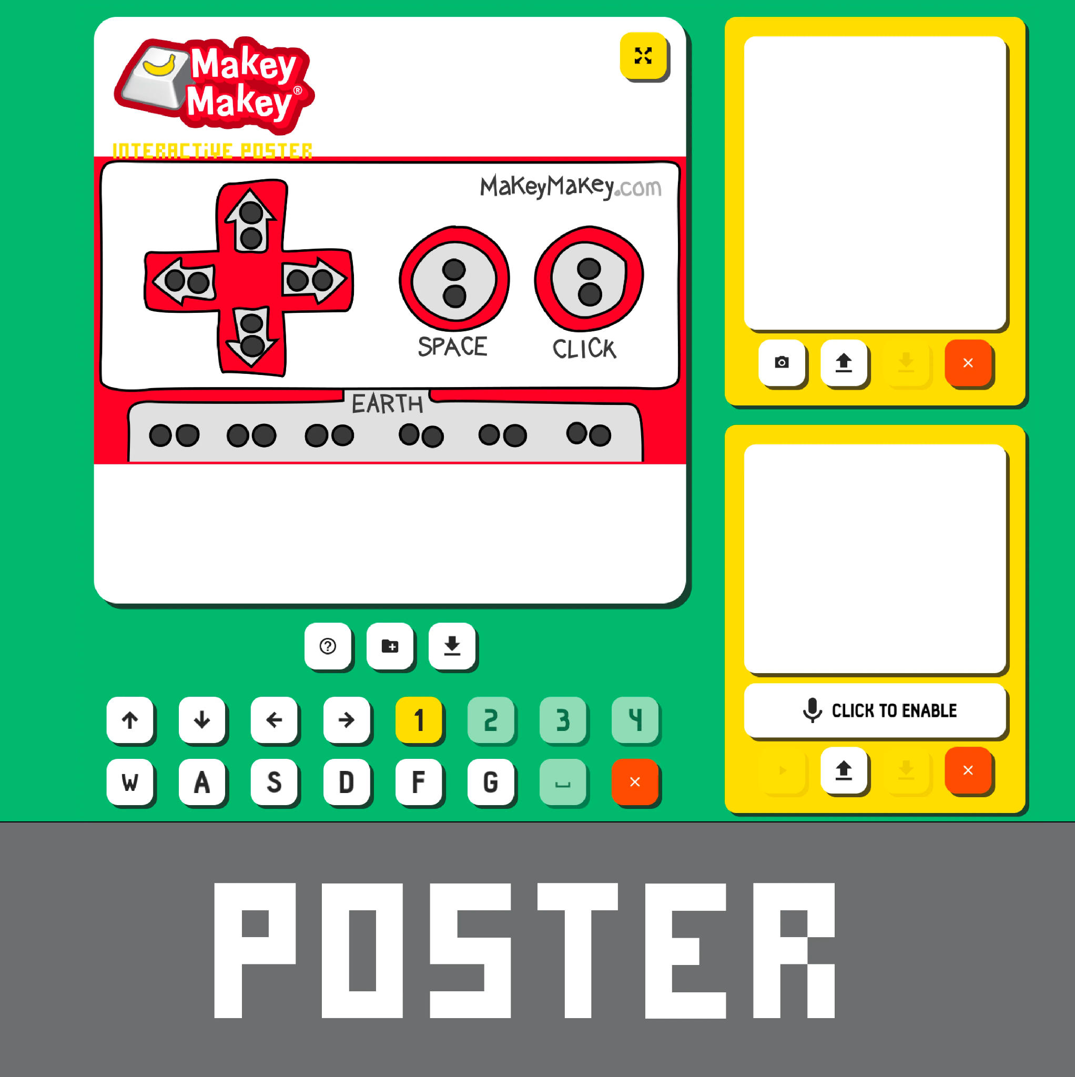
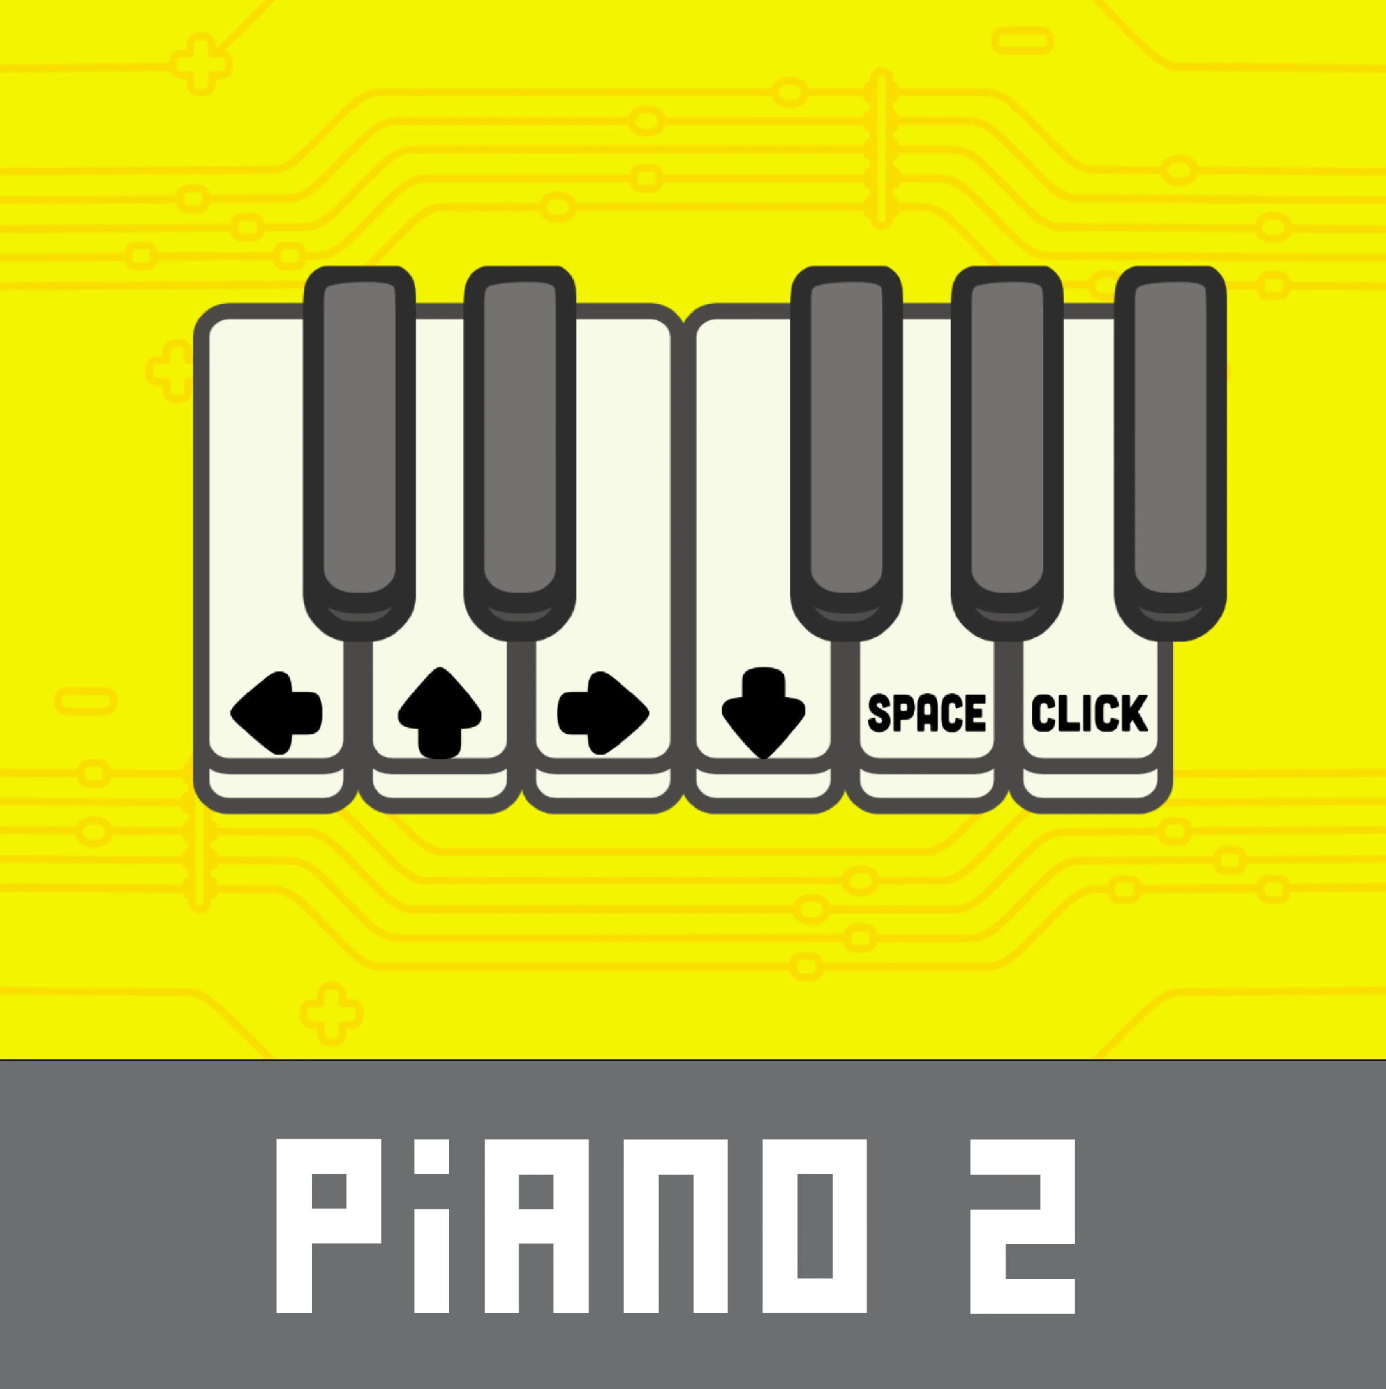
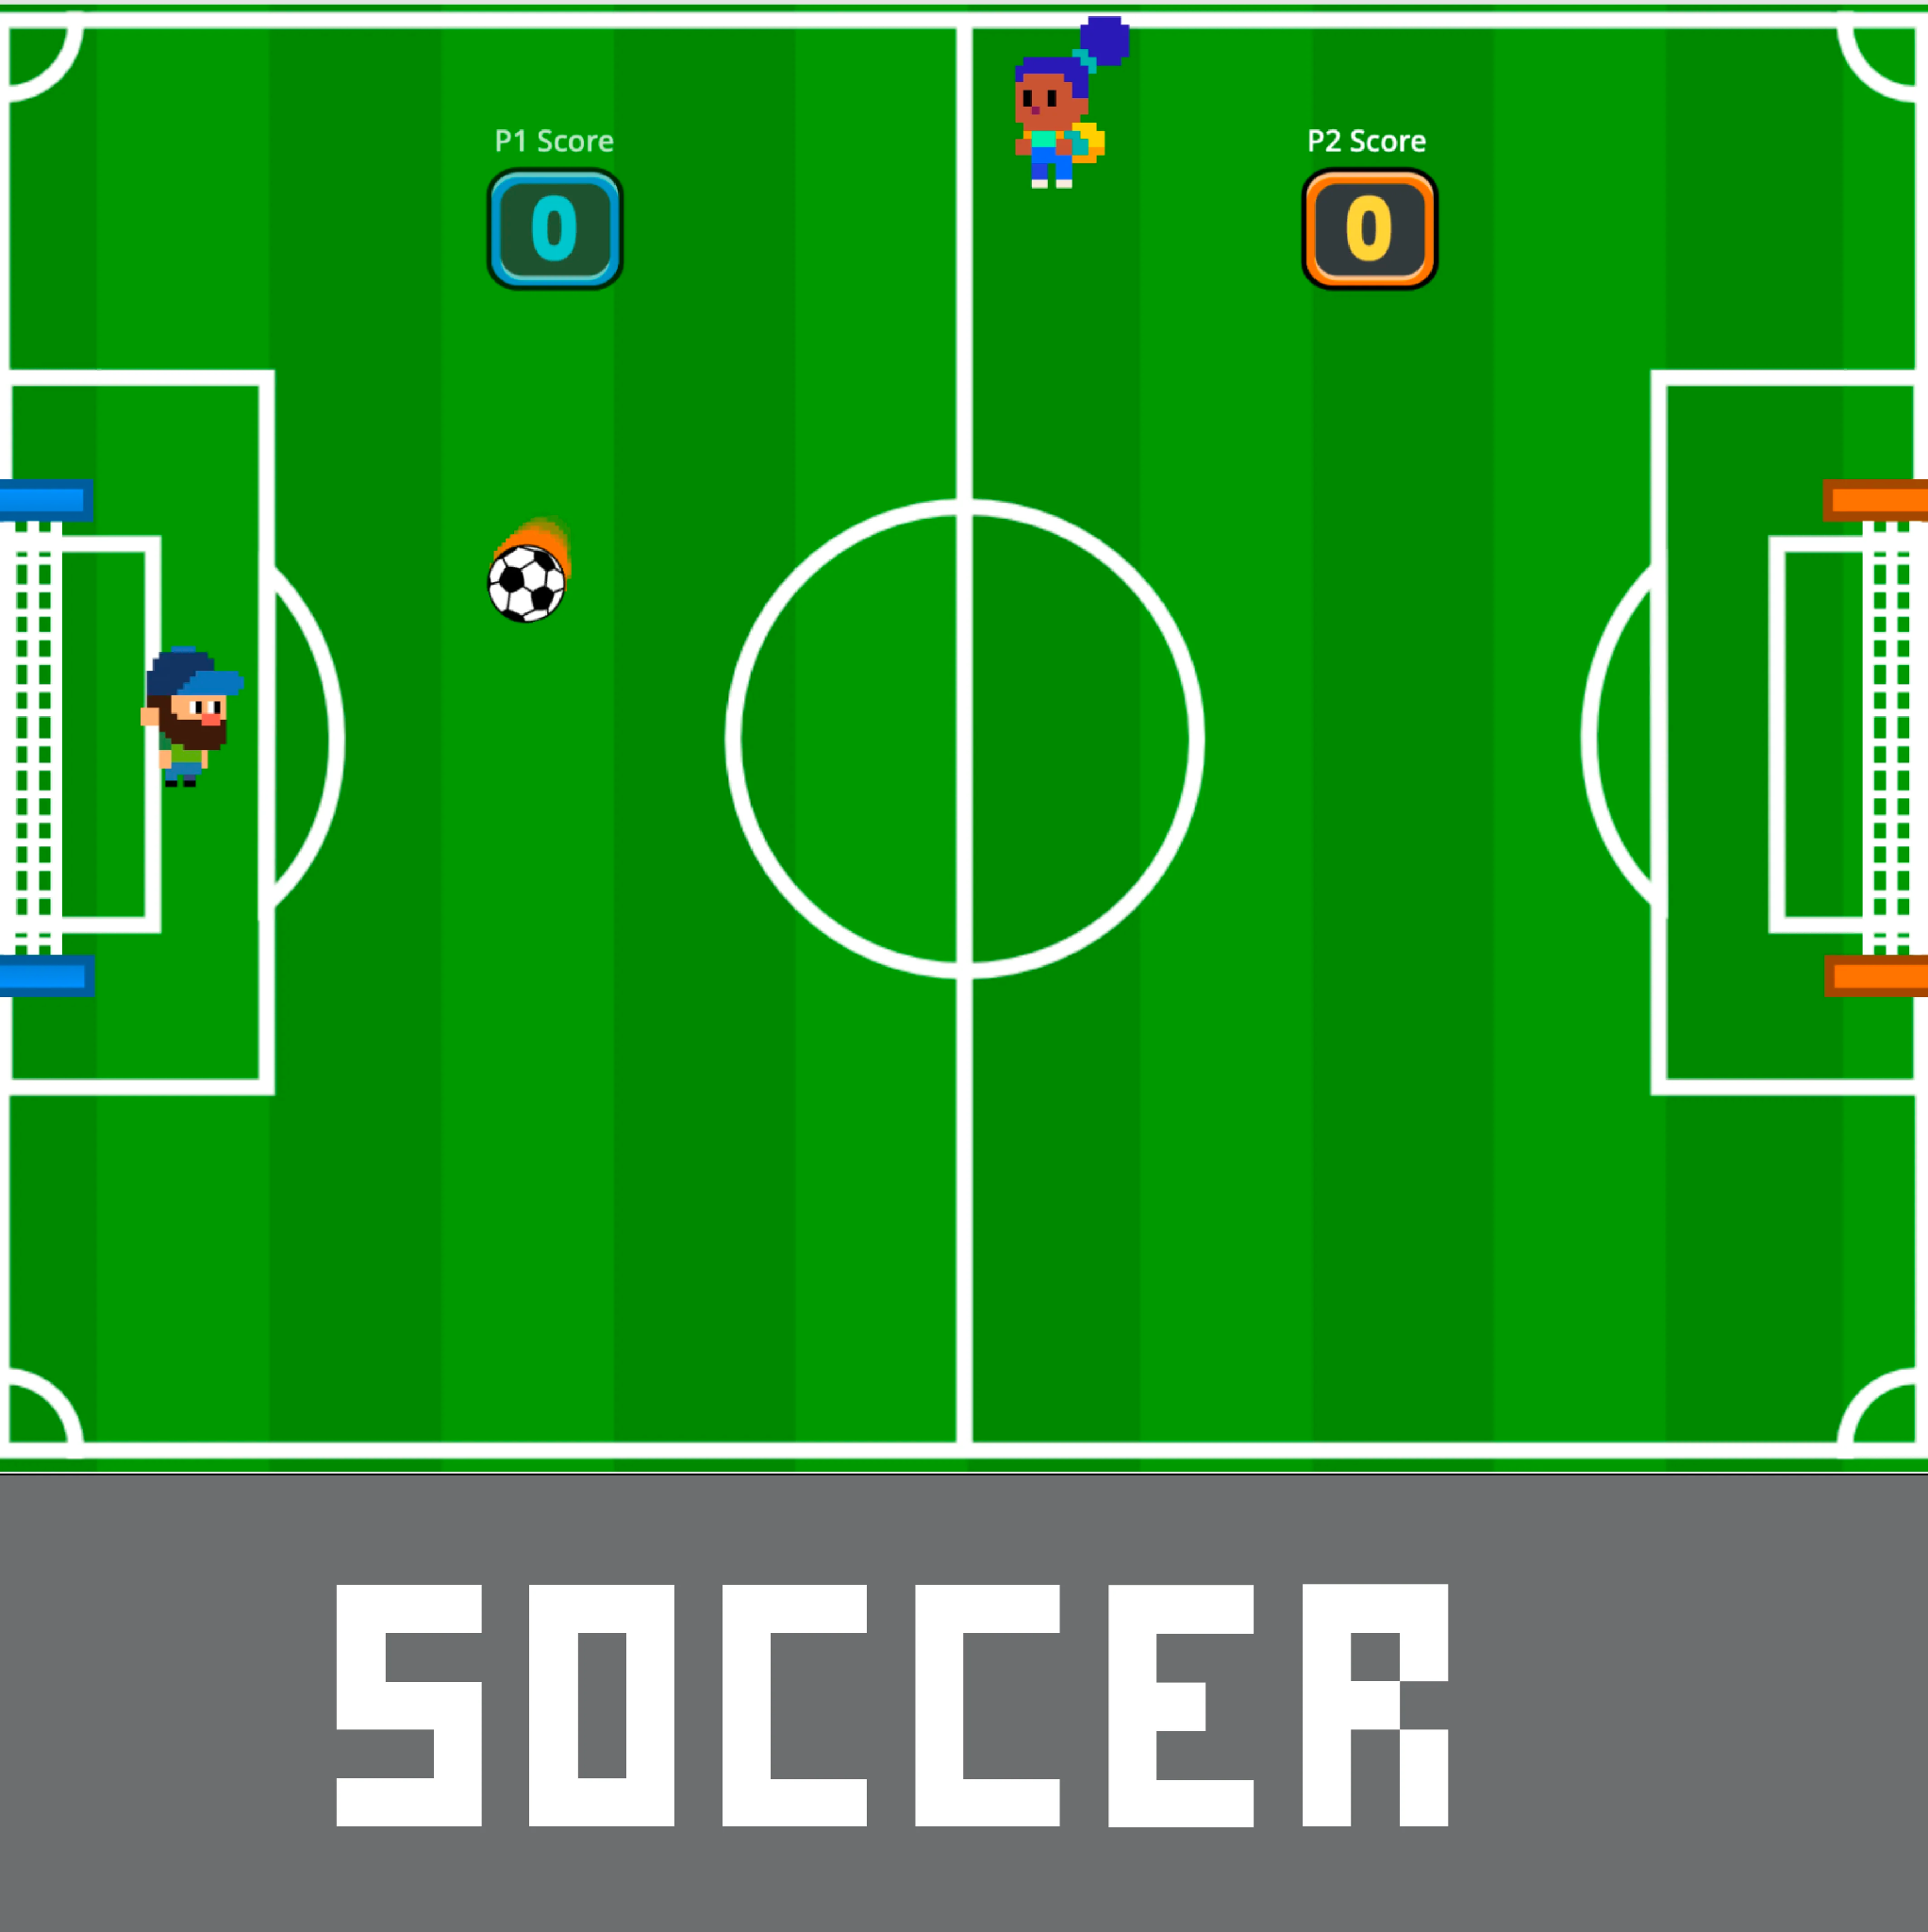
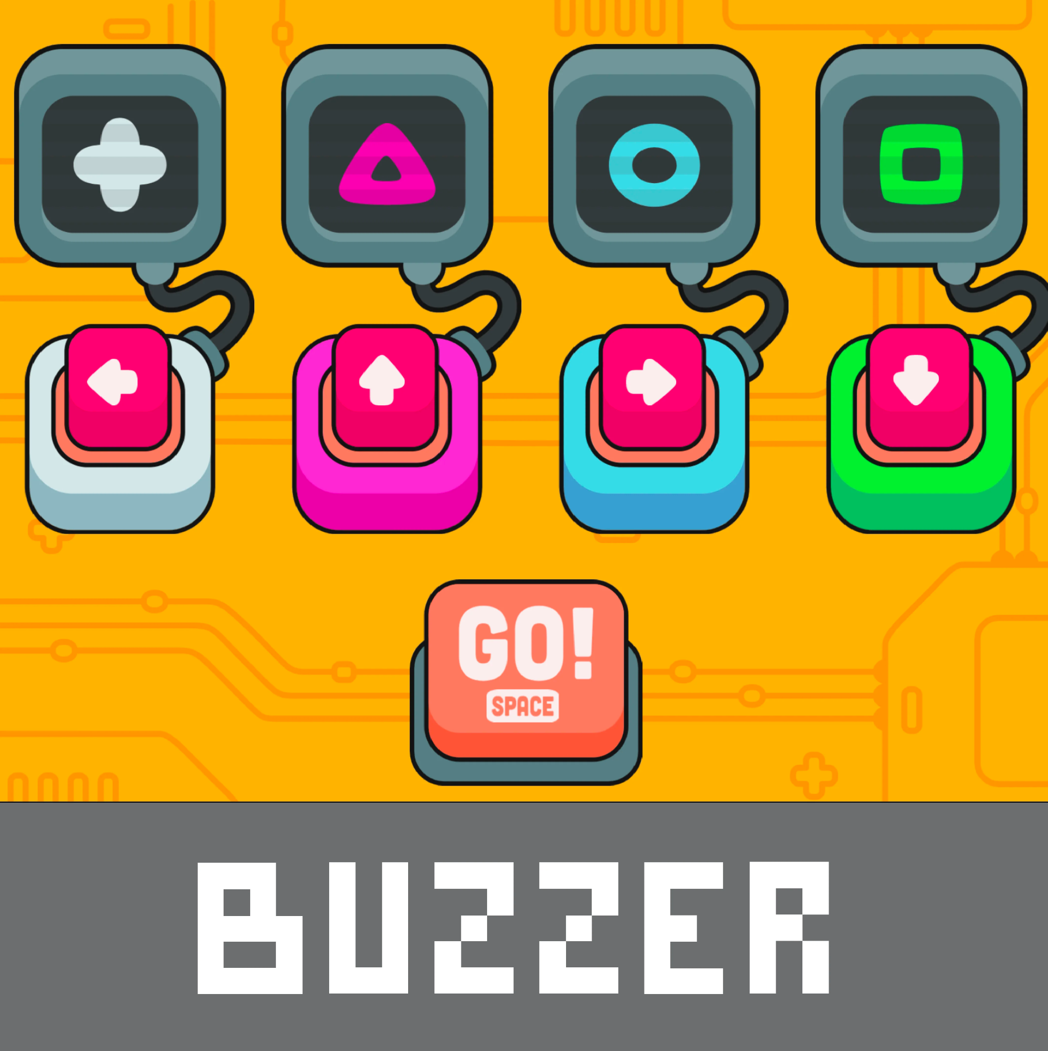
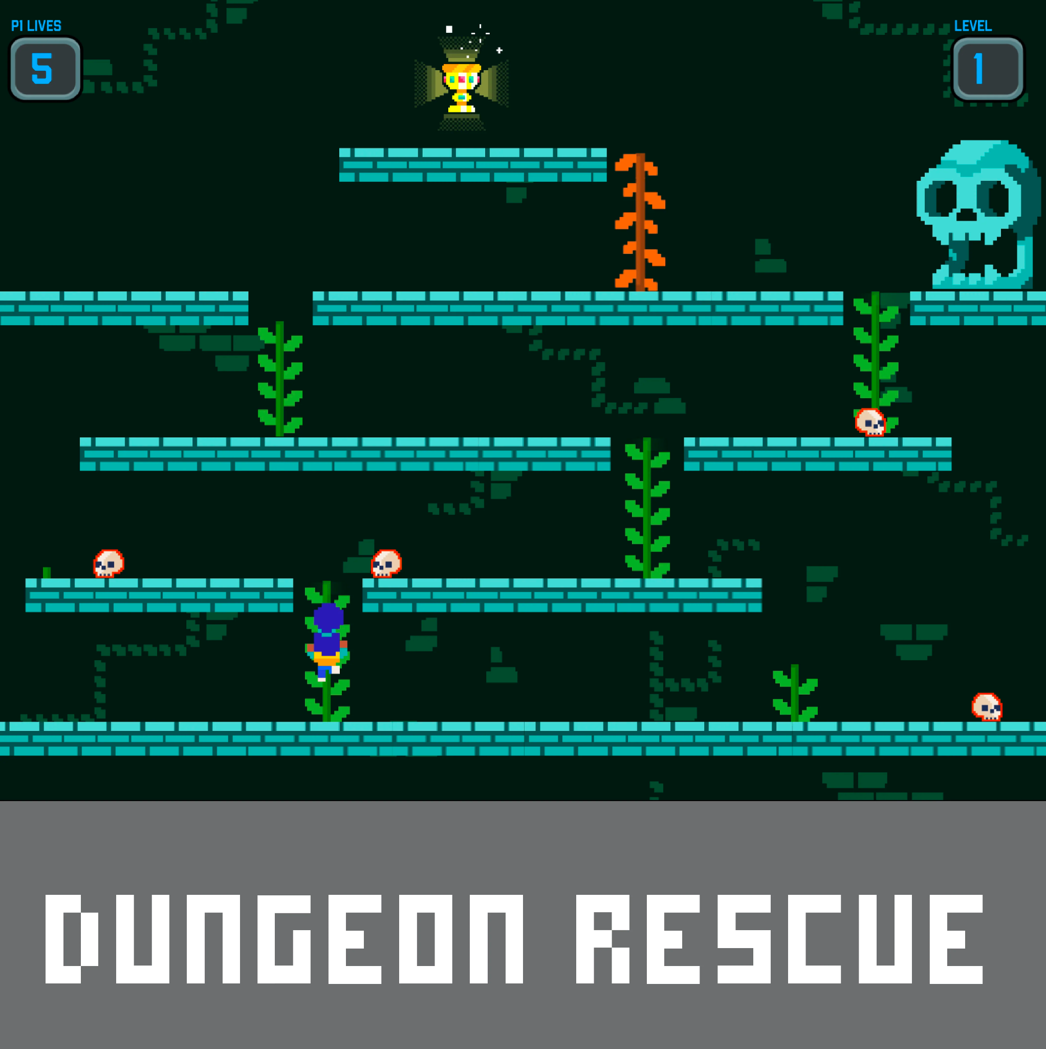
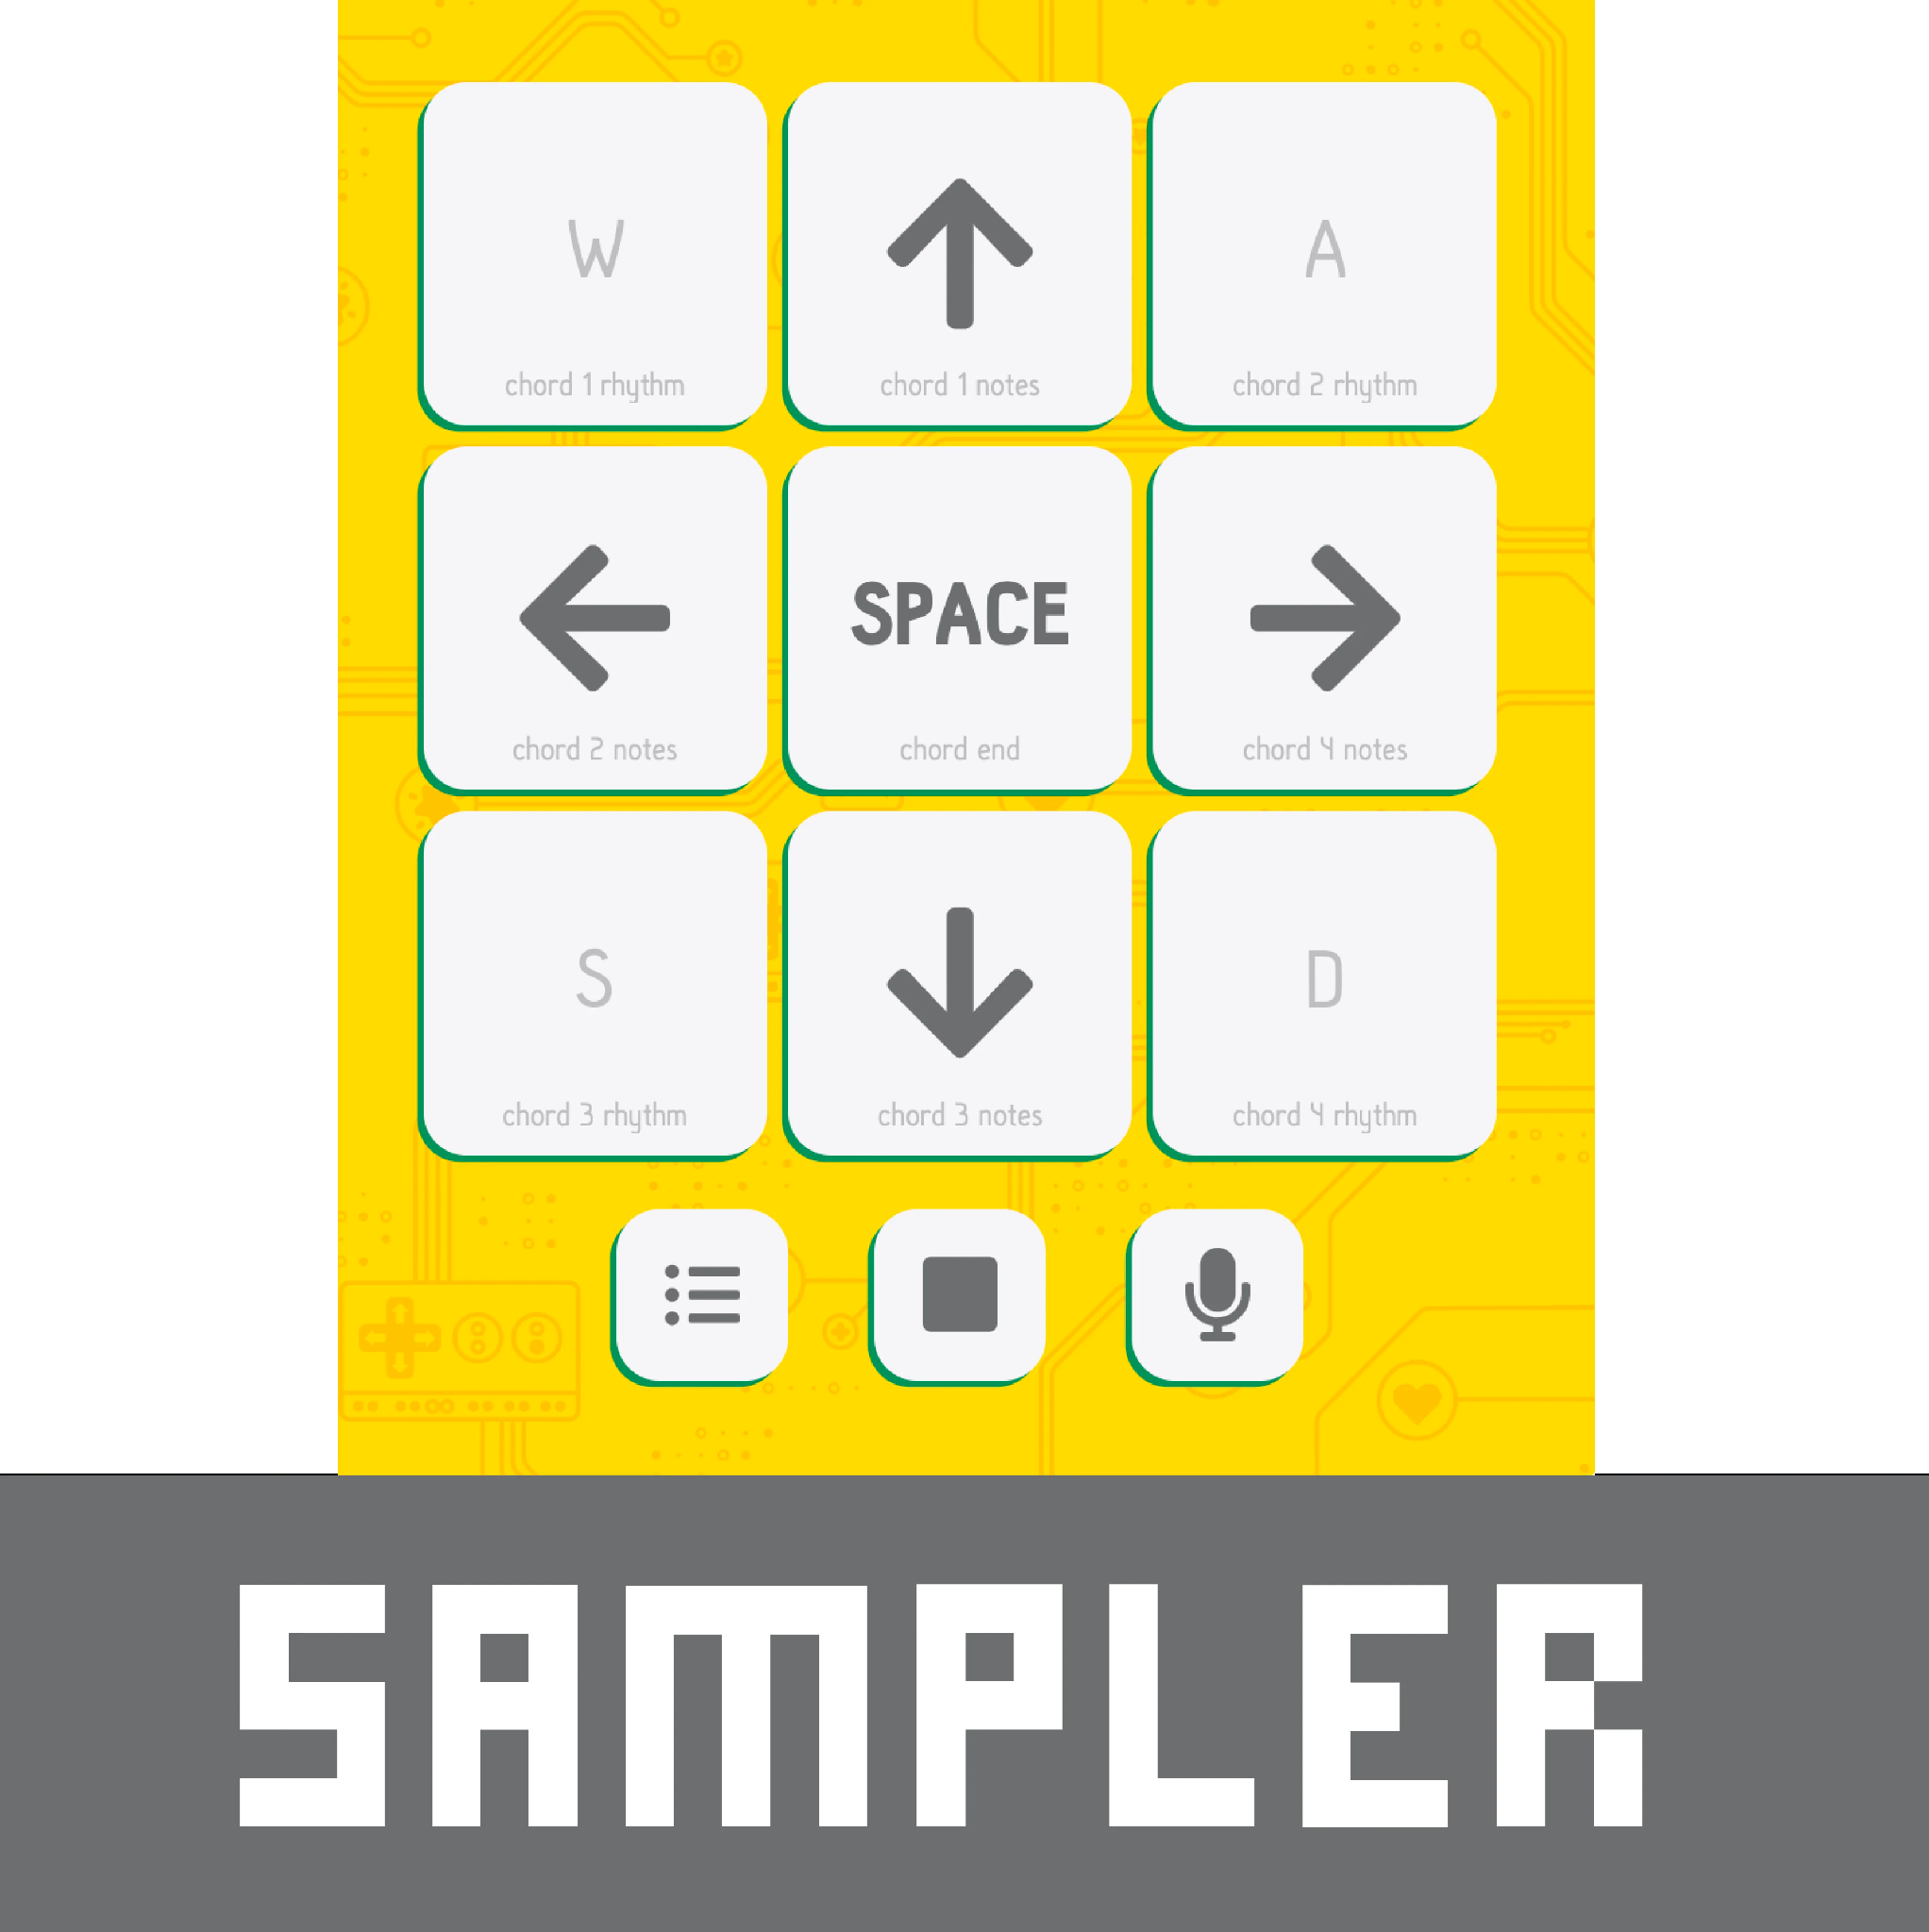
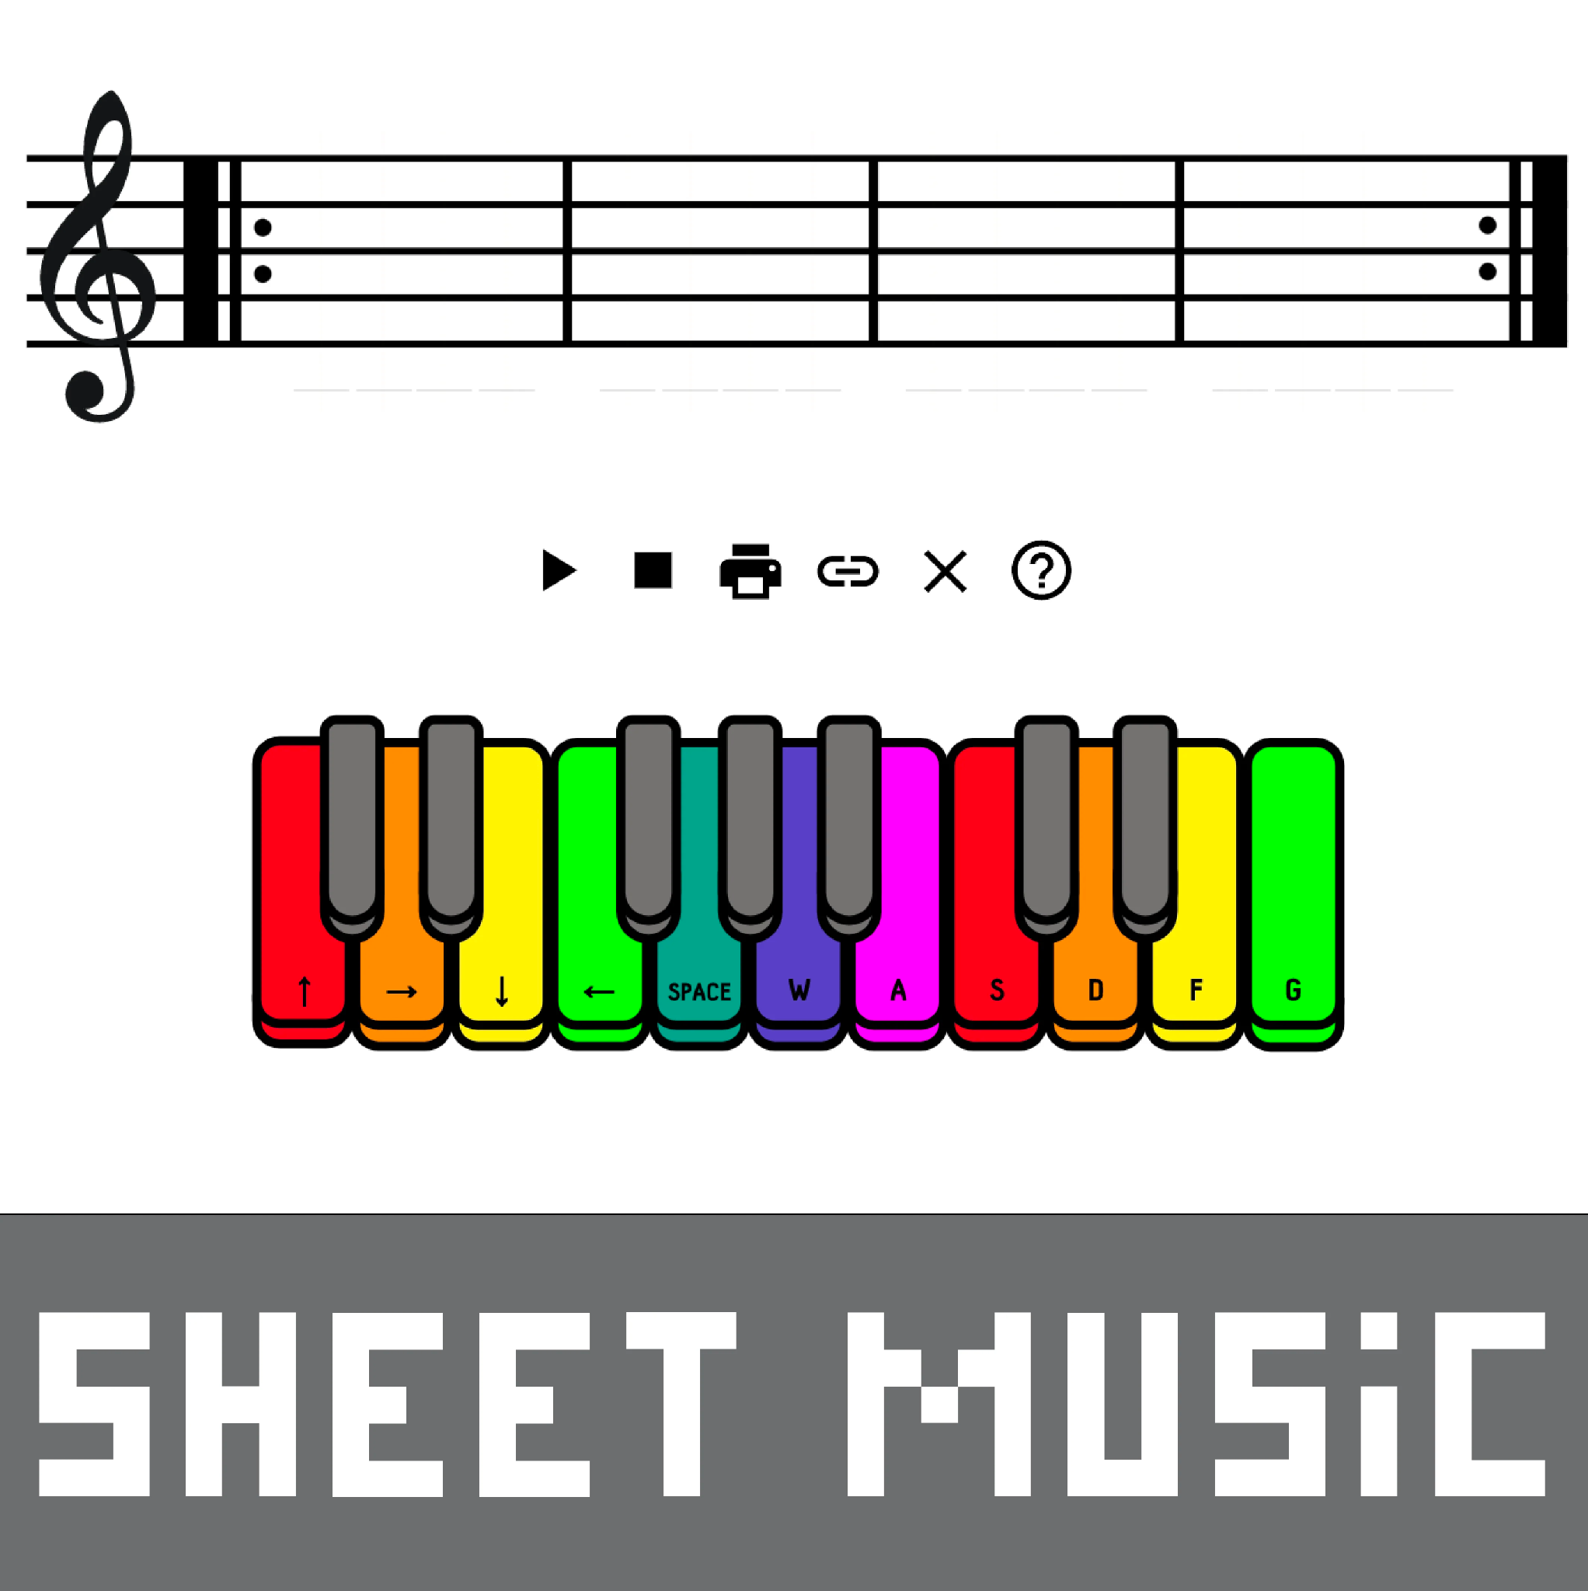
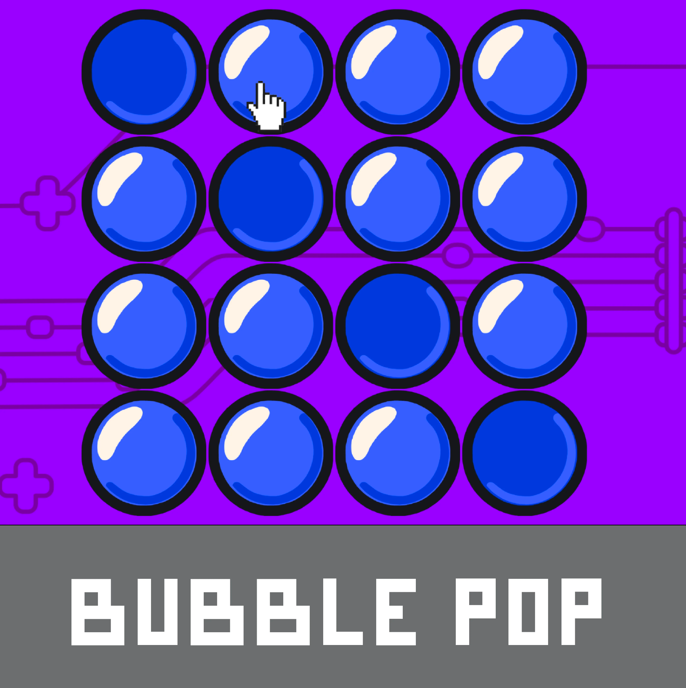
Controlling Apps with the world around you!
Notes:
Pacing 1 minute
ANA
The Makey Makey website has lots of different apps that you can control with the Makey Makey. There are some of the traditional apps, such as the Piano, and several new apps, such as Interactive Sheet Music, Bubble pop, and more!
Do:
Point out how to access all the apps from the website. Point to some they’ve already explored.
https://makeymakey.com/pages/plug-and-play-makey-makey-apps

Slide 26
Added Value of Makey Makey
Designed as an open platform, compatible with most tech already in the classroom and with finds from the grocery store, hardware store, last night‘s dinner leftovers.
Supported by the JoyLabz Education Team – former teachers with extensive experience providing for small classrooms and large school systems.
Constantly updated FREE online resource for classroom activities and instructional guides.
An engaged, global community of educators sharing ideas, experiences, and lesson plans online.
Regular live-streaming and recorded webinars with JoyLabz Edu Team and special guests highlighting projects ideas, classroom case studies, cross-product mash-ups.
Professional Development for educators offered by a nationwide network of trained and certified providers.
Favored for its accessibility by instructors seeking to engage a diversity of learning styles
and by occupational therapists accommodating a wide range of learning, physical, and behavioral abilities.
Notes:
Eli

Slide 27



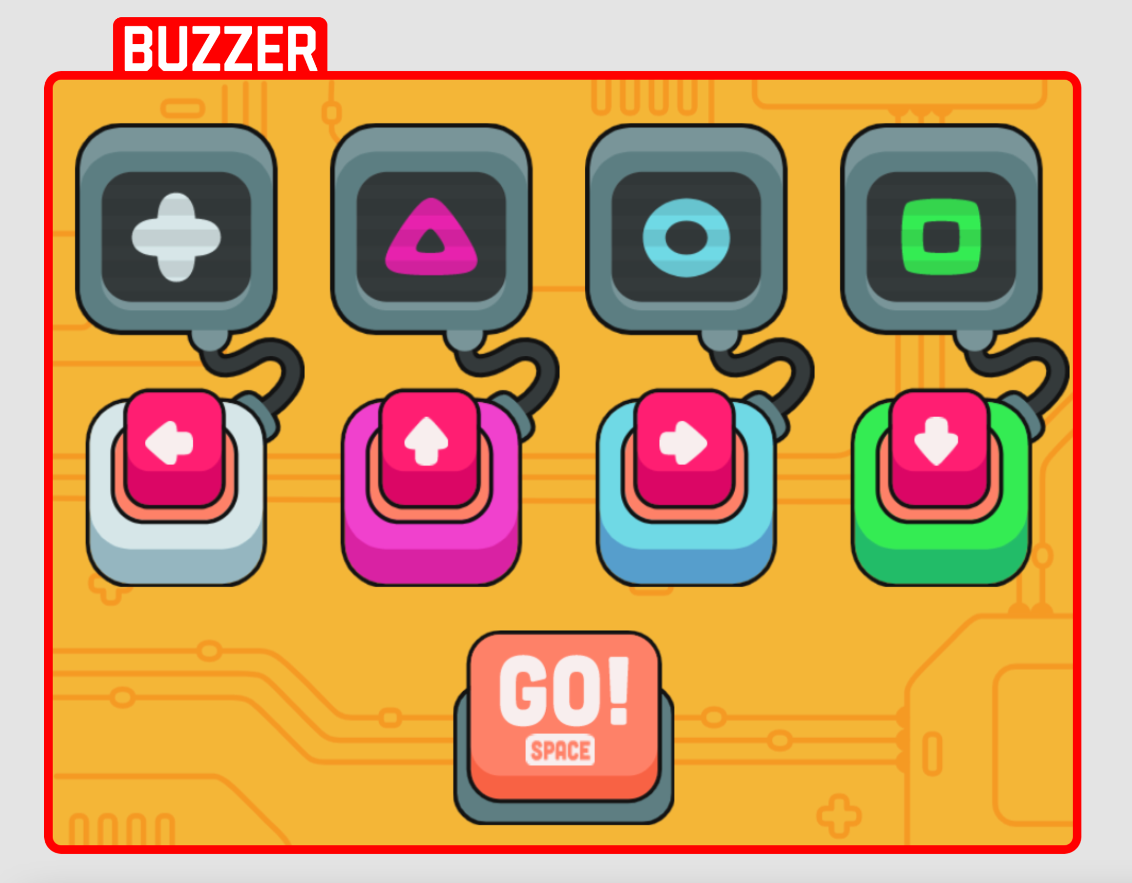
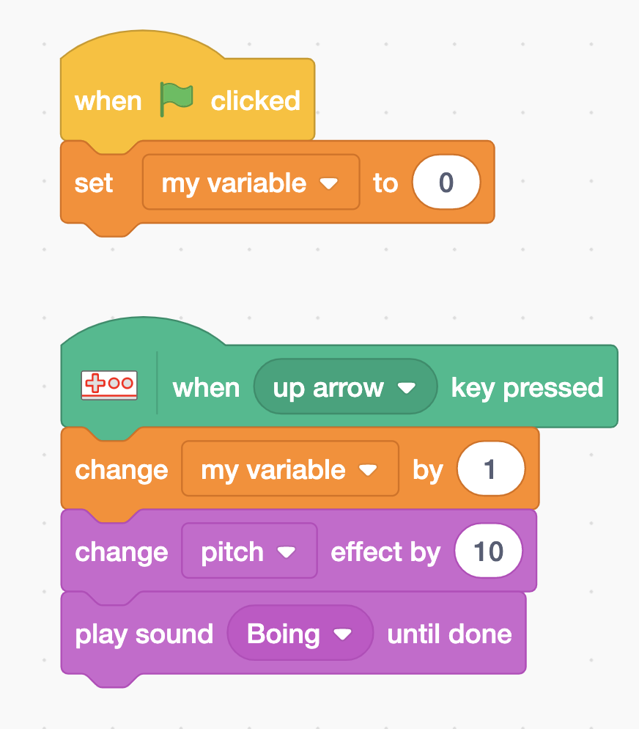

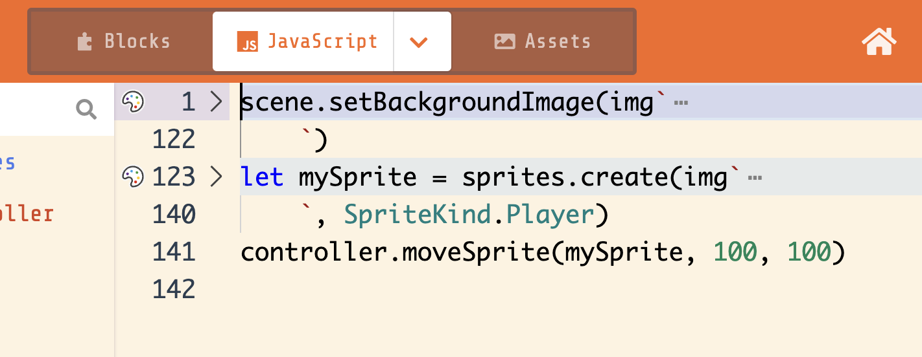
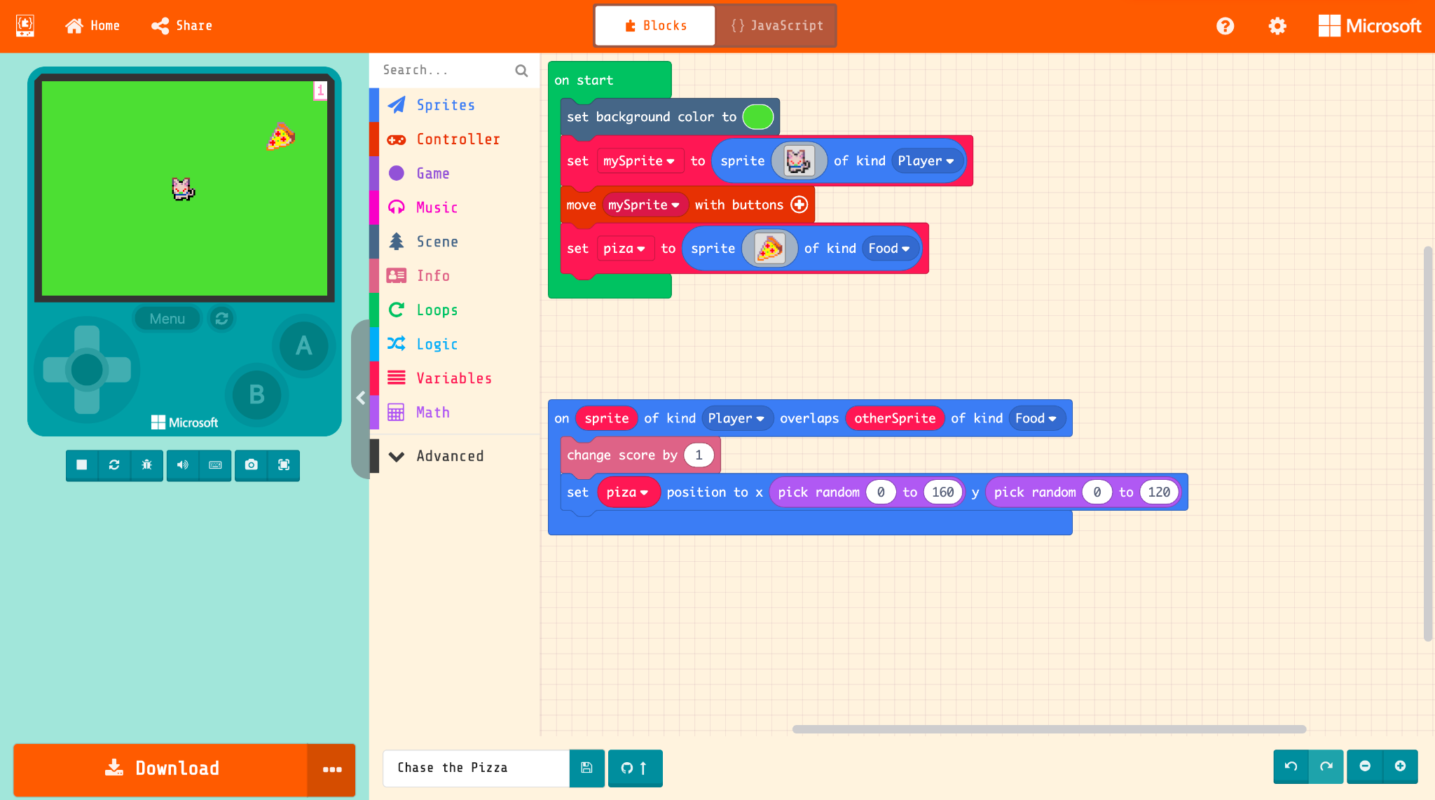
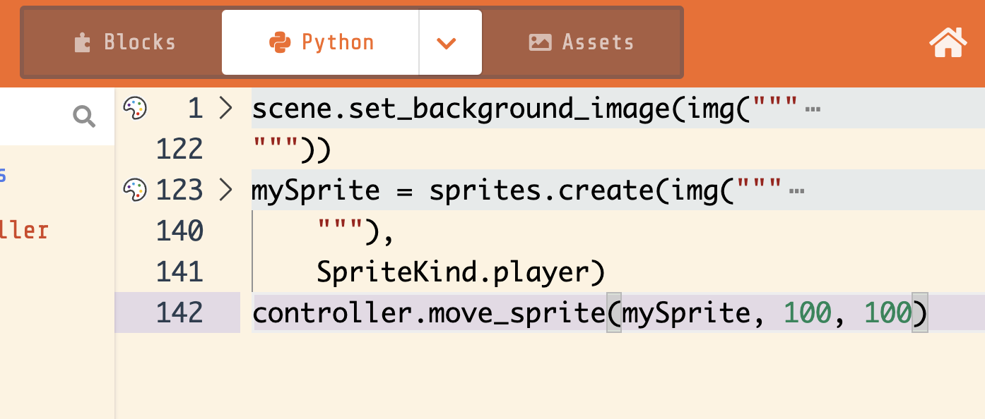
Makey Makey CS/Coding Progression…
3rd - 4th
Makey Apps
4th - 7th
Scratch
6th - 8th
MakeCode Arcade
9th - 12th
Python, JS, Processing
Notes:
Eli

Slide 28
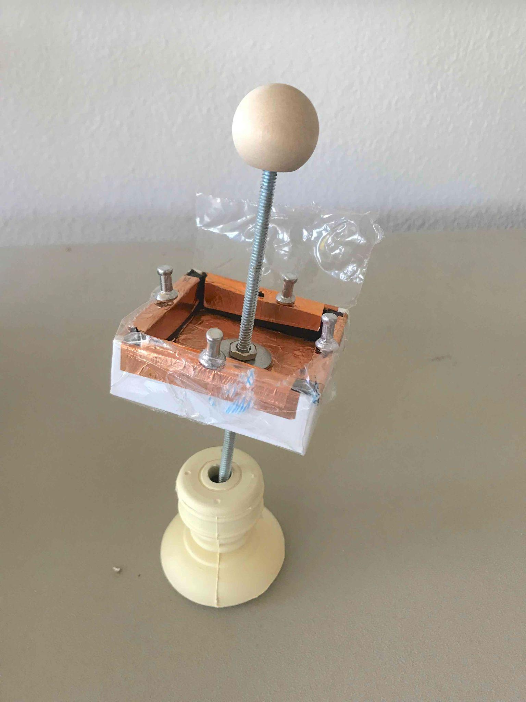
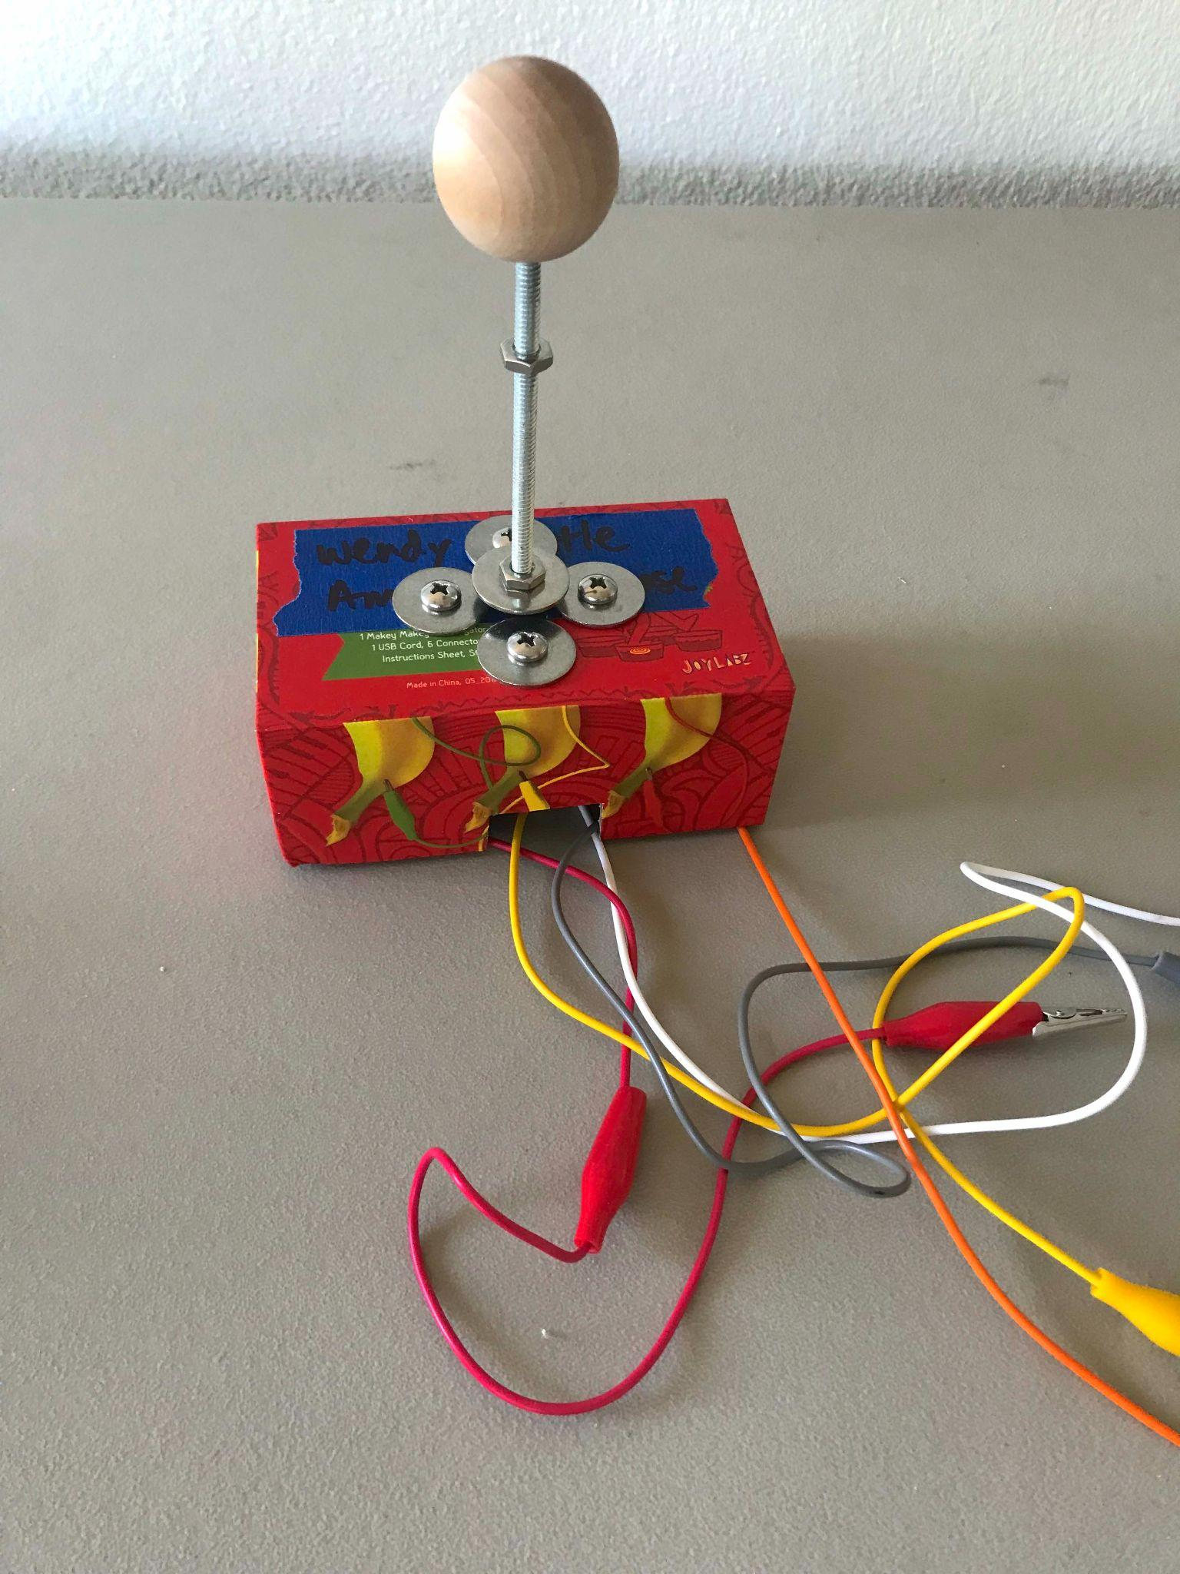
Early Engineering & Creative Problem Solving
Some of the subjects our educators teach with Makey Makey:
Circuits & Switches
Conductivity / Insulators & Conductors
Logic & Computational Thinking
Physical Computing
(off-screen constructions + interactions)
Tinkering & Reverse Engineering
Basic Physics (a la Rube Goldberg)
Problem Solving & Creative Thinking
Design Thinking
Brainstorming & Prototyping
Teamwork, Collaboration & Empathy
Notes:
Colleen

Slide 29
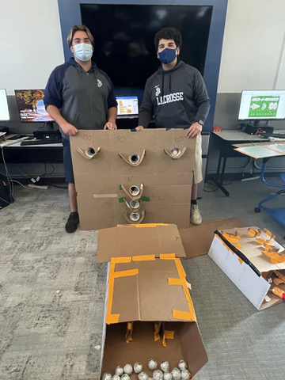
Beyond STEM / Integrated STEM
Some of the things our educators build with Makey Makey:
Games (Game Design)
Life-size Board Games
Musical Instruments
Interactive Posters
Storytelling Panoramas
Interactive Art Installations
Quizzes
Game Shows (Buzz-in)
Race Courses (STEM in the Gym)
Notes:
Colleen

Slide 30
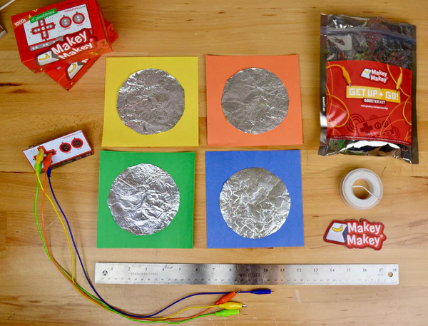
Synthesize Learning: Kids Create Quiz Show
ELA - Read book or chapter
Students write questions for the quiz show
Students build their own Quiz Show buzzers
Groups of students rotate to answer quiz Show questions Family Feud Style.
Notes:
SHERRY
If you’re wondering about the content connections, here are some ideas.

Slide 31
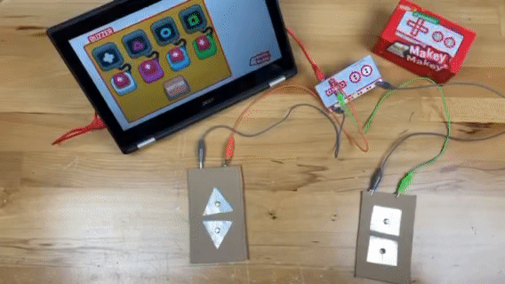
Integrating Curriculum Tip:
Synthesize Learning- Reading Skill Focus
Students sample books and take notes.
Teachers focus on a reading skill for their quiz show:
  Sequence
  Main Idea
  Compare / Contrast text structures
  Author’s Purpose
  Making Connections across texts
  Judgements or Generalizations
  Fact or Opinion
Notes:
SHERRY
Another ELA example, but really any topic can work!

Slide 32
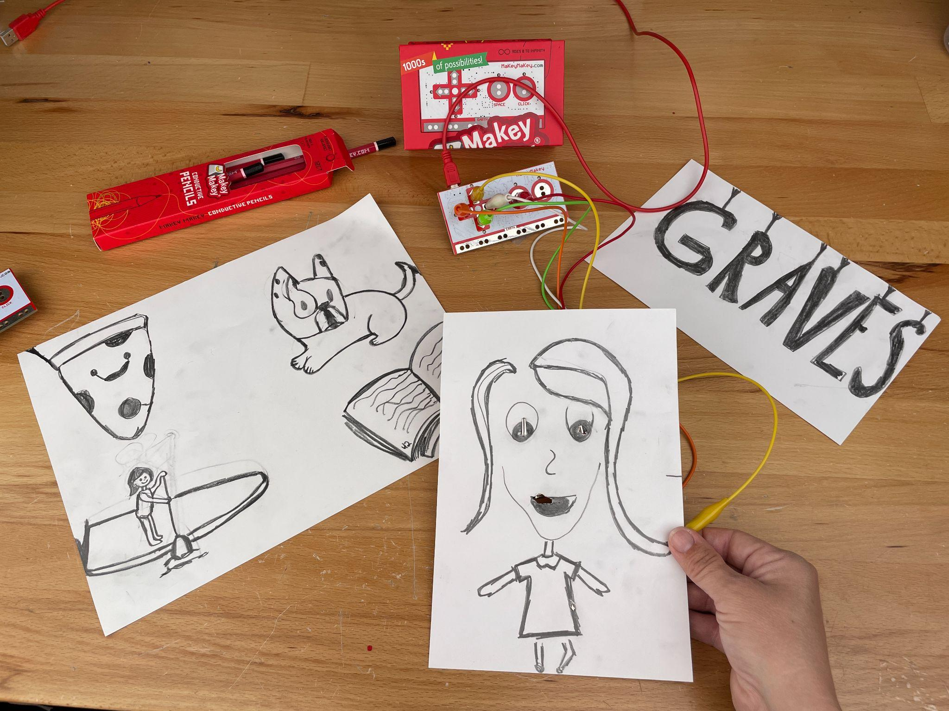
Drawing Ideas
Retell a fairy tale
Create a Self portrait
Draw four items that represent you
Draw your name!

Slide 33
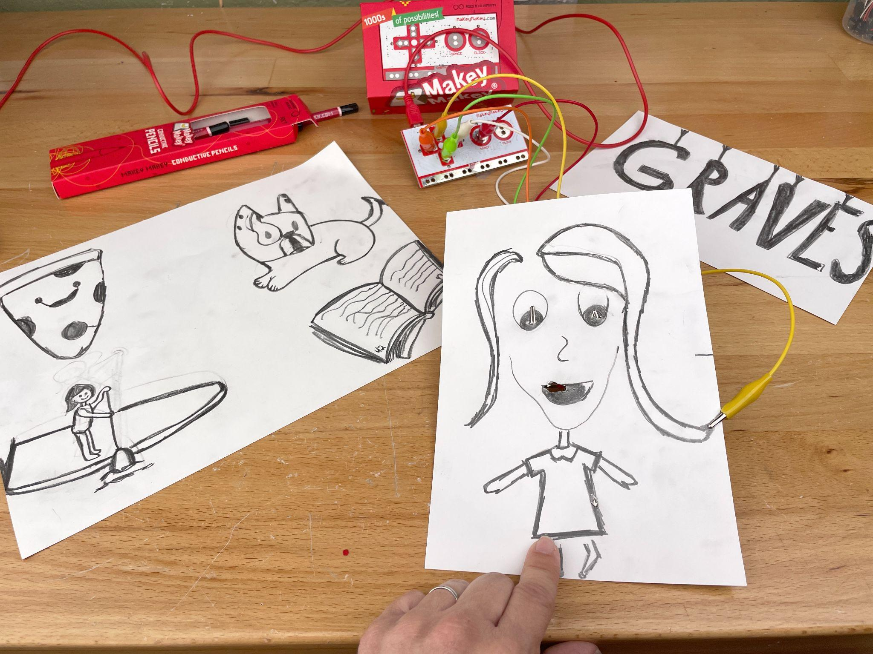
Drawing Circuits
Run to edge of paper
Create a simple sketch using the 6B pencil and paper
Connect an alligator clip to your sketch near the edge of your paper
Use your sketch to control the Makey Makey Sampler or Poster App.
Don’t forget to hold on to earth or make a controller for it
Thick Lines
Leave space between doodles
Notes:
Cynthia

Slide 34
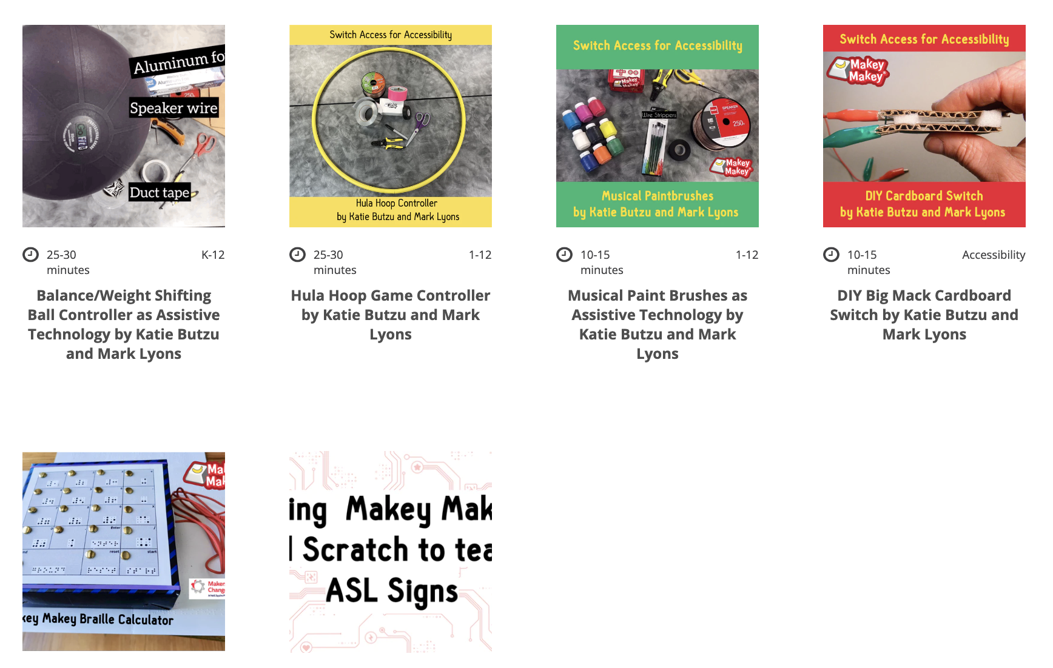
Makey Makey for Accessibility
Notes:
Colleen

Slide 35
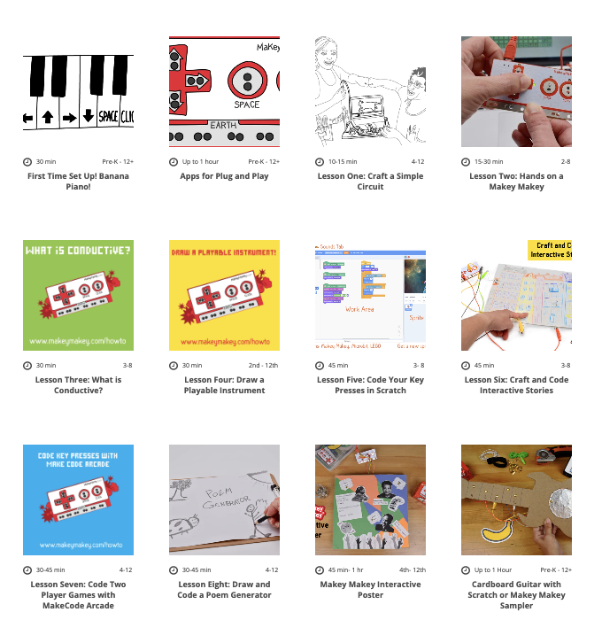
Teacher Resources:
MakeyMakey.com/Apps
MakeyMakey.com/Howto
bit.ly/MakeyMakeyTeacher
bit.ly/MakeyClassroomSlides
Notes:
Eli

Slide 36
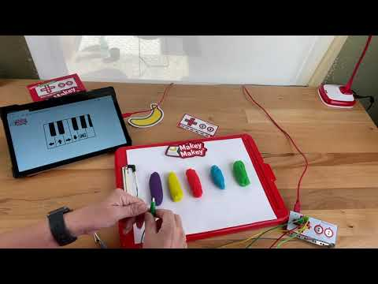
Video demo of Play-doh Piano: MakeyMakey.com/Piano

Slide 37
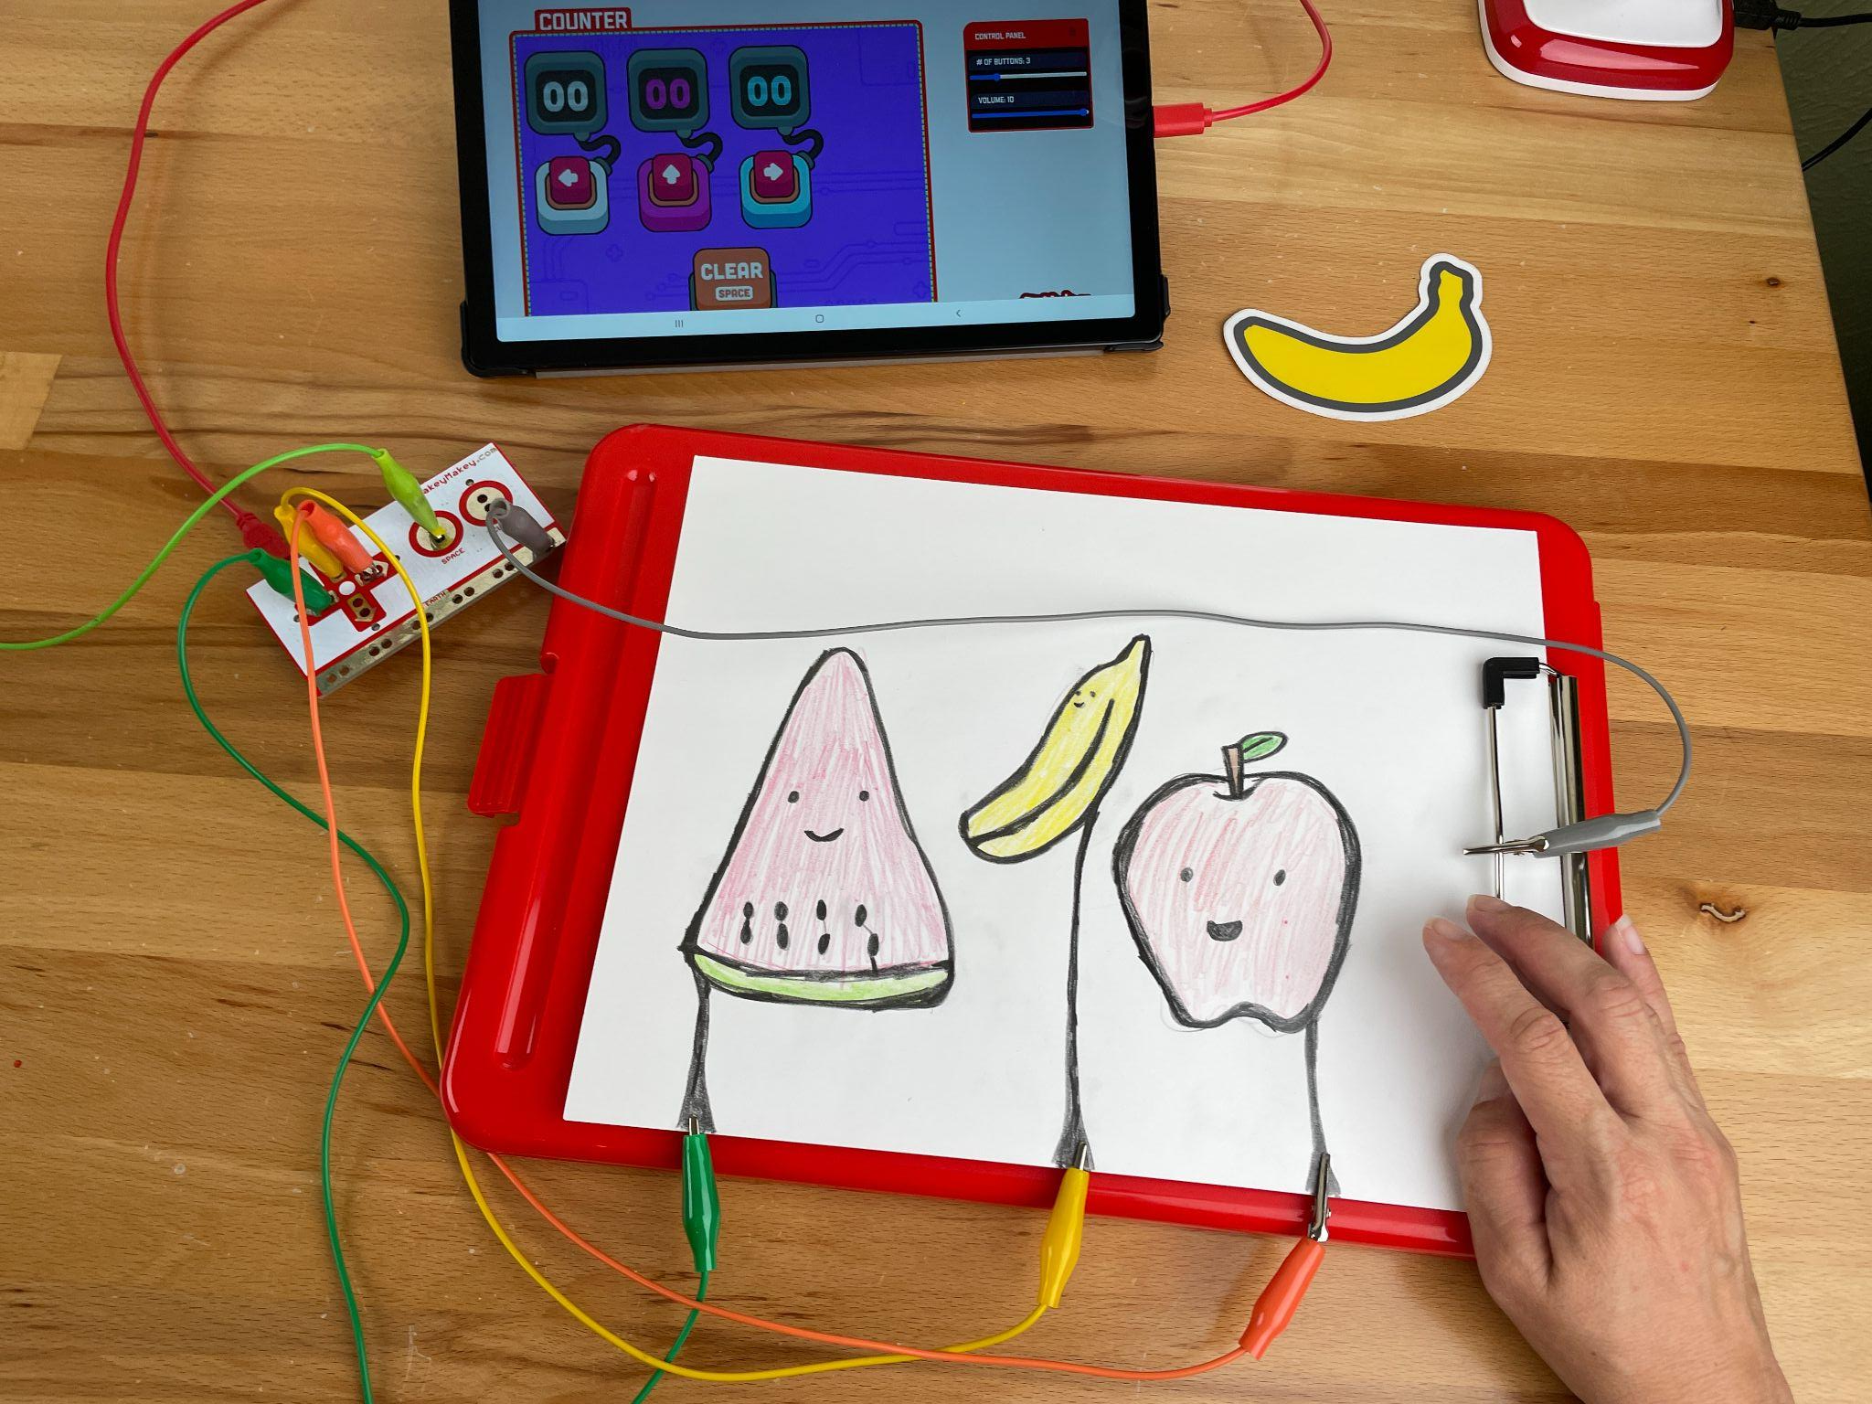
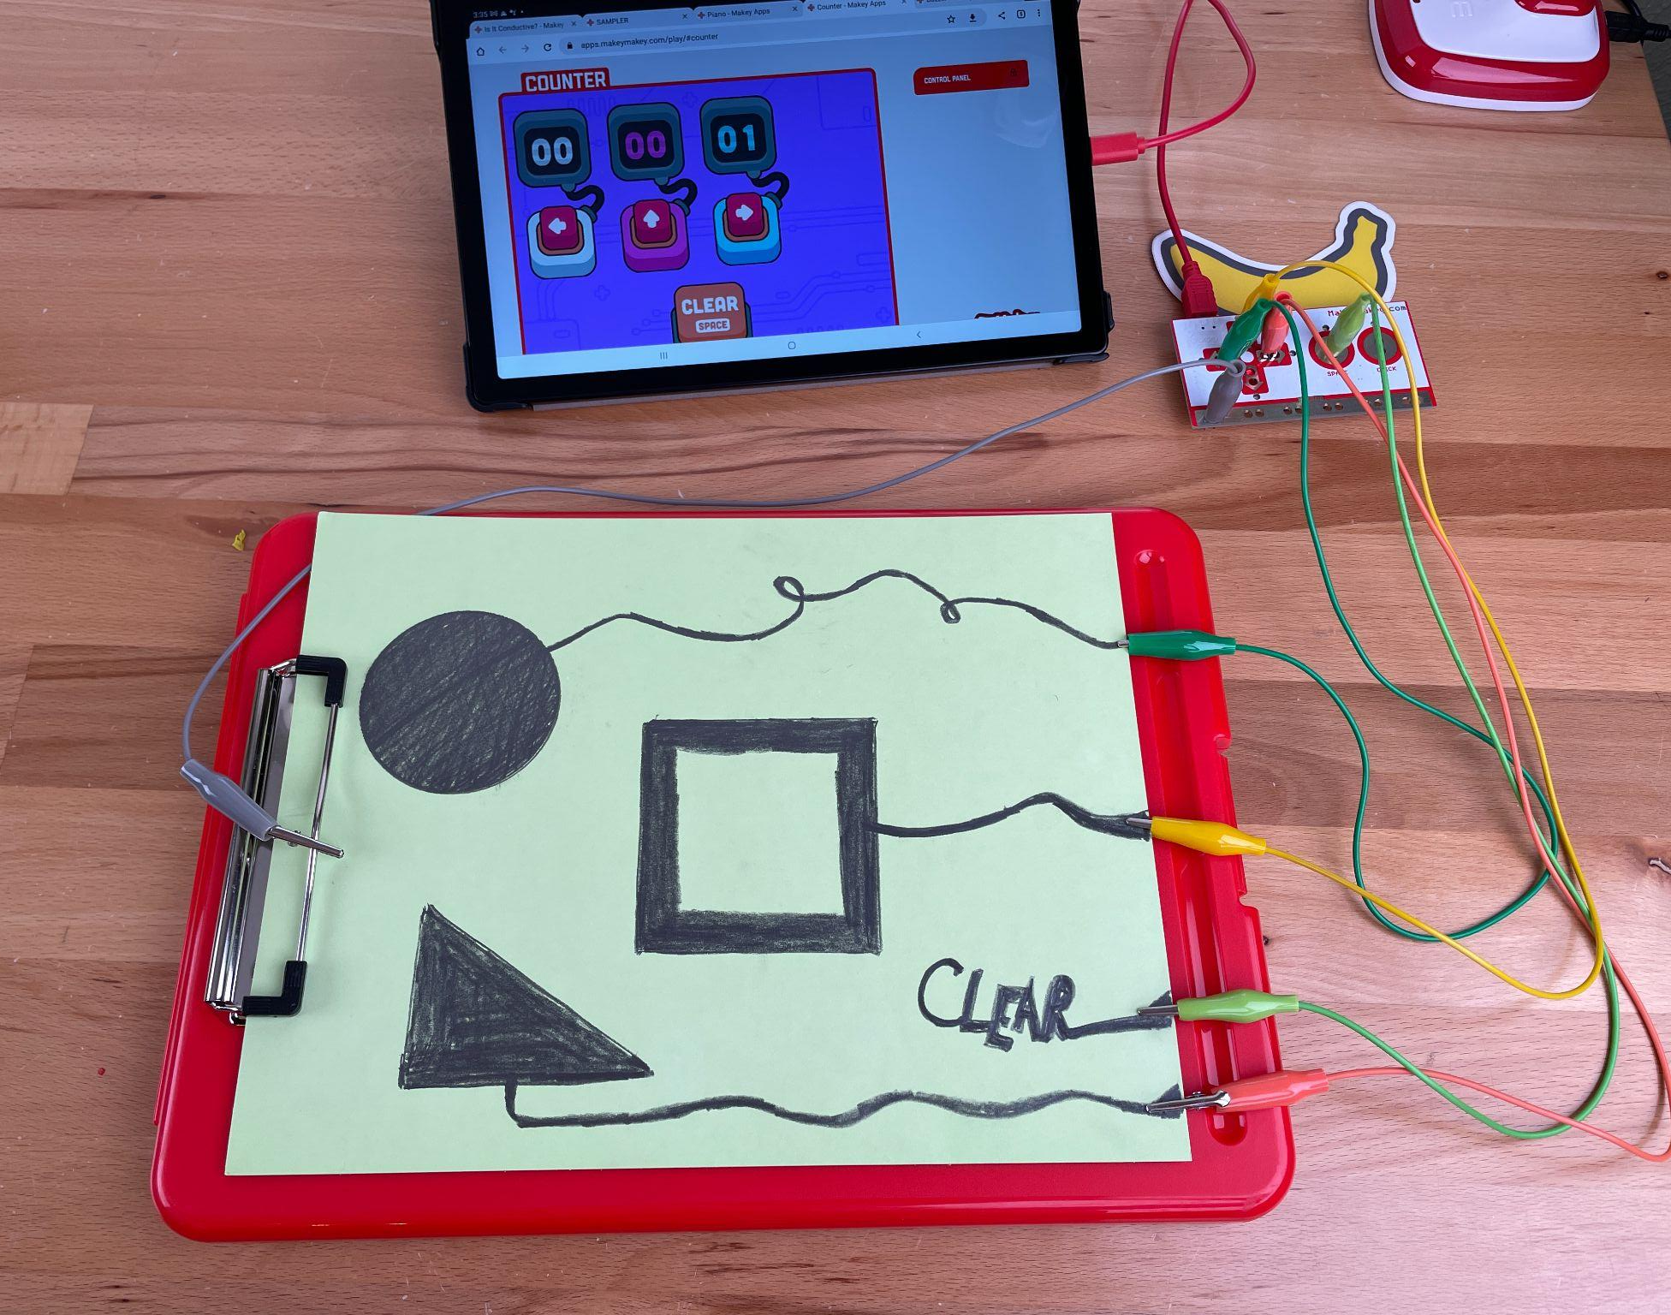
Counter App: https://apps.makeymakey.com/play/#counter

Slide 38

Video of drawing with app: https://apps.makeymakey.com/play/#counter

Slide 39
THANKS!
Reach out to any of us at sales@joylabz.com

