Slide 2
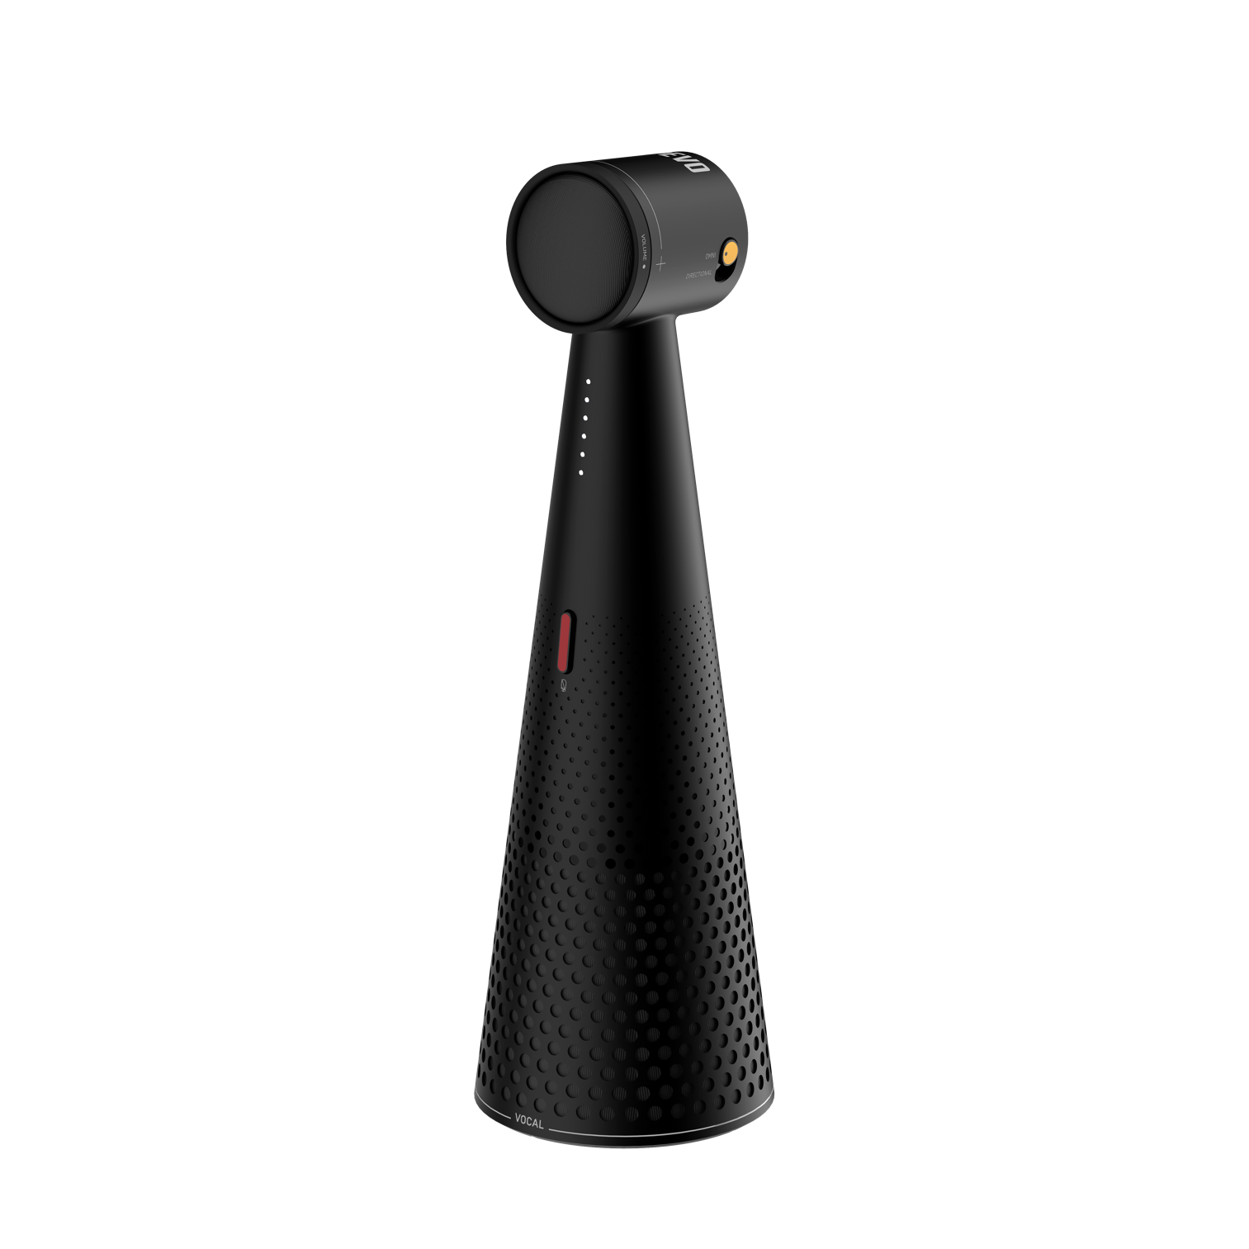
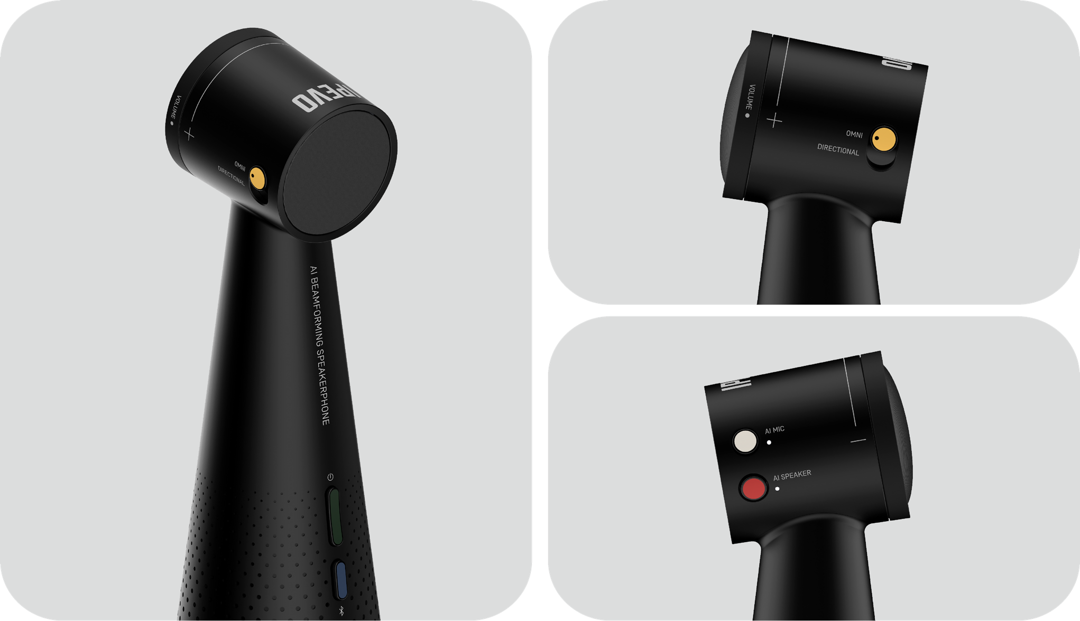
IPEVO VOCAL
AI Beamforming Bluetooth Speakerphone
World's first uplink and downlink AI noise reduction functionality powered by IntelliGo's Technology.
AI trained with over 500 million distinct data to maintain the natural sound of the human voice while removing noise with high accuracy.
Switch between two microphone modes: 120° unidirectional and 360° omnidirectional
Convenient tabletop microphone shape with wireless Bluetooth connection
Up to 16ft (5m) audio pickup radius

Slide 3
The TOTEM series leads the new Era of Hybrid Communication with an immersive collaboration and communication model that integrates online and offline work across all professions.
Multimodal Collaboration Camera
Panoramic Conference Camera
Immersive Conferencing System

Slide 4
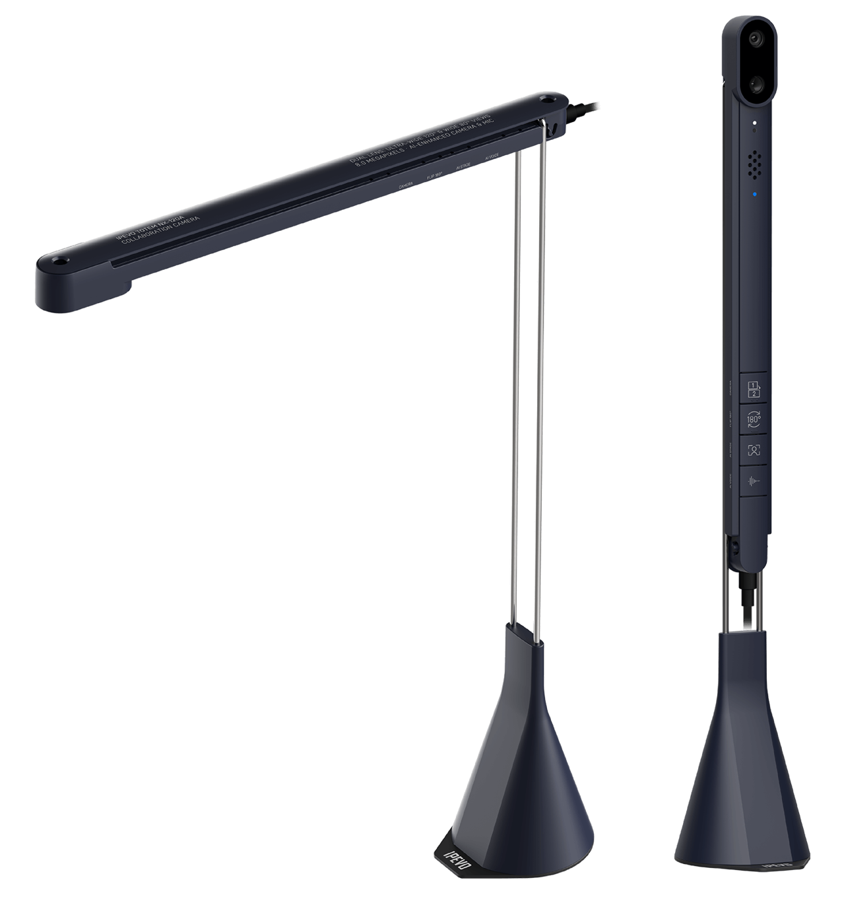
IPEVO TOTEM 120
Multimodal Collaboration Camera
4K Dual-Lens video conference camera
120° FOV Ultra-Wide Lens ideal for huddle rooms and online presentations
80° FOV Autofocus Lens ideal for document sharing and individual video calls
The on-board “AI Stage” automatically frames the person, or multiple participants, at the center of the image
The microphone with “AI Voice” reduces disturbing background noise and enhances the human voice
Conference Cam + Demo Cam + Document Cam all in ONE Device.
Ideal for 1 to 4 people meetings
Place directly in front of screen or participants
Use slider rail design to adjust camera for eye-level conversations, live demonstrations or document sharing.

Slide 5
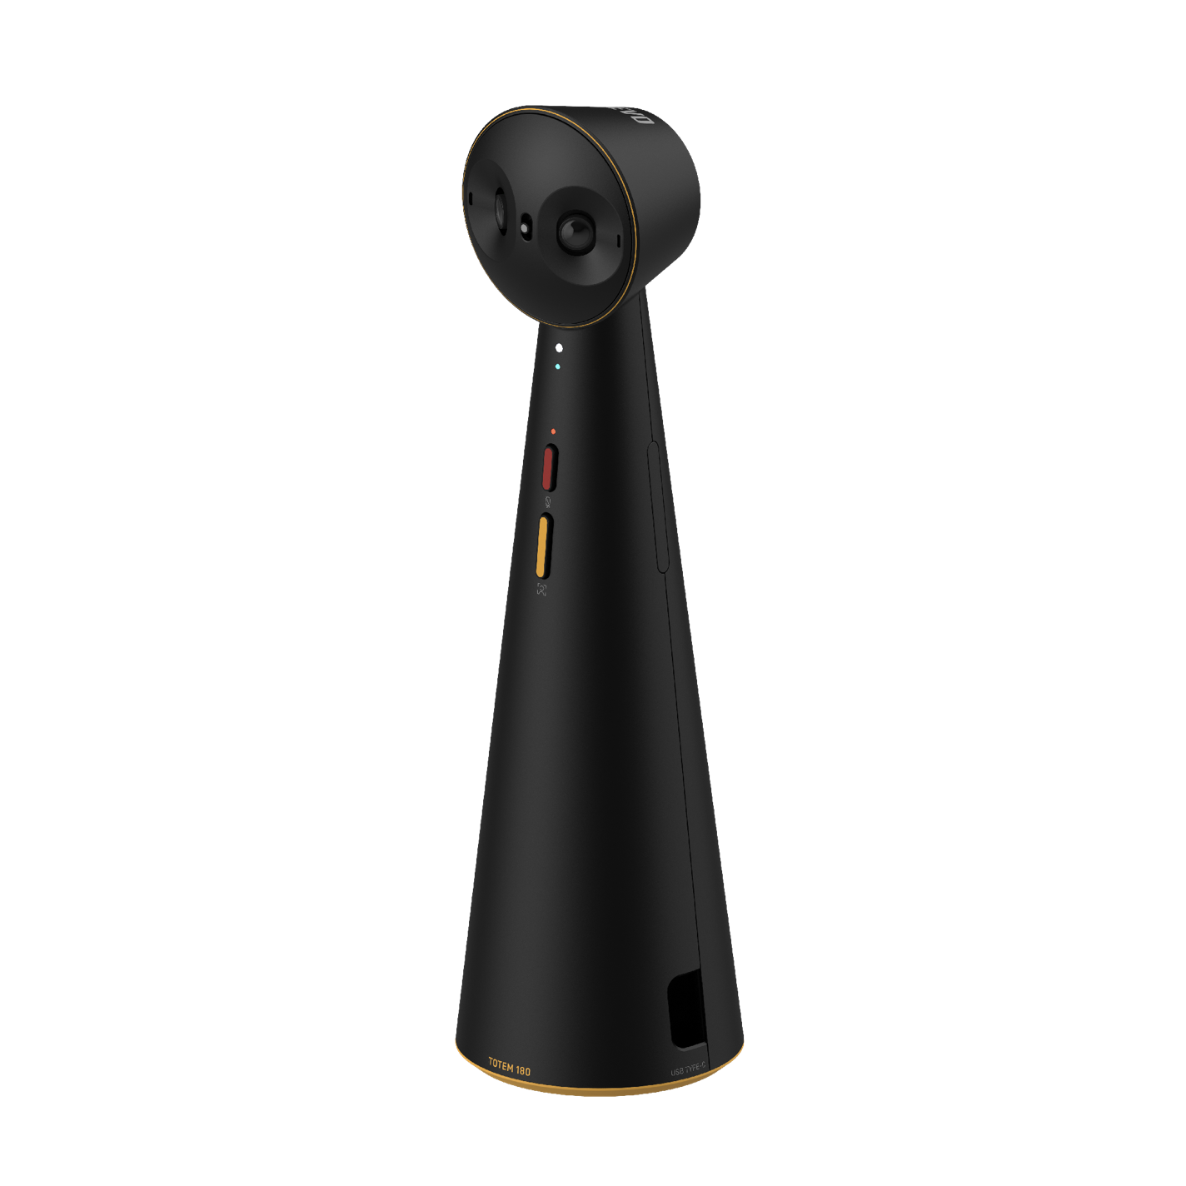
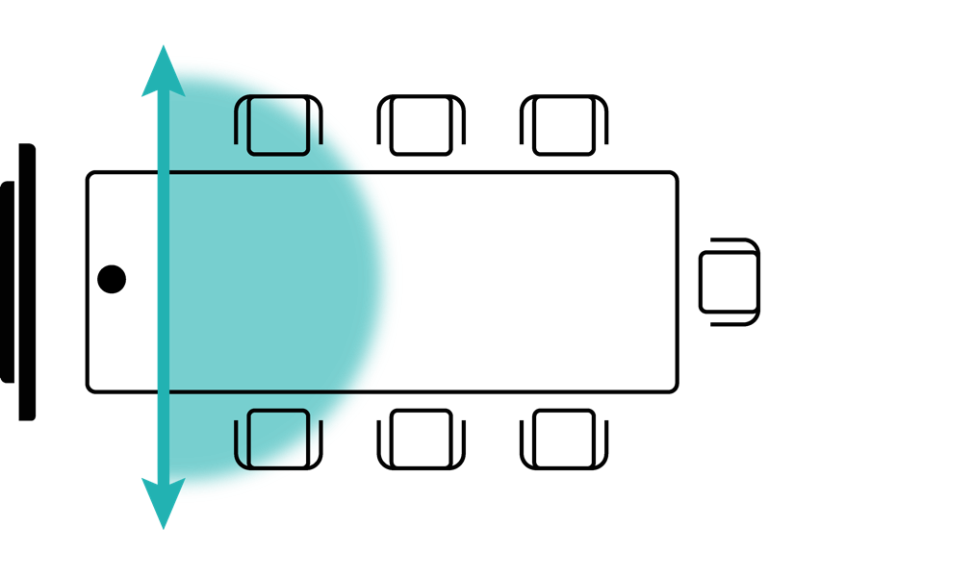
IPEVO TOTEM 180
Panoramic Conference Camera
Capture the whole room via two 4 MP cameras that provide a seamlessly stitched 180° view
The on-board “AI Stage” automatically frames the person, or multiple participants, at the center of the image
The two omnidirectional microphones with built-in Background Noise Reduction with an audio pickup radius of up to 16ft(5m)
USB-C connection. Plug and Play
Ideal for 4 to 6 people meetings
Place directly in front of screen or at the edge of the table
Camera modes: 180° Full room view and 120° Small group view

Slide 6
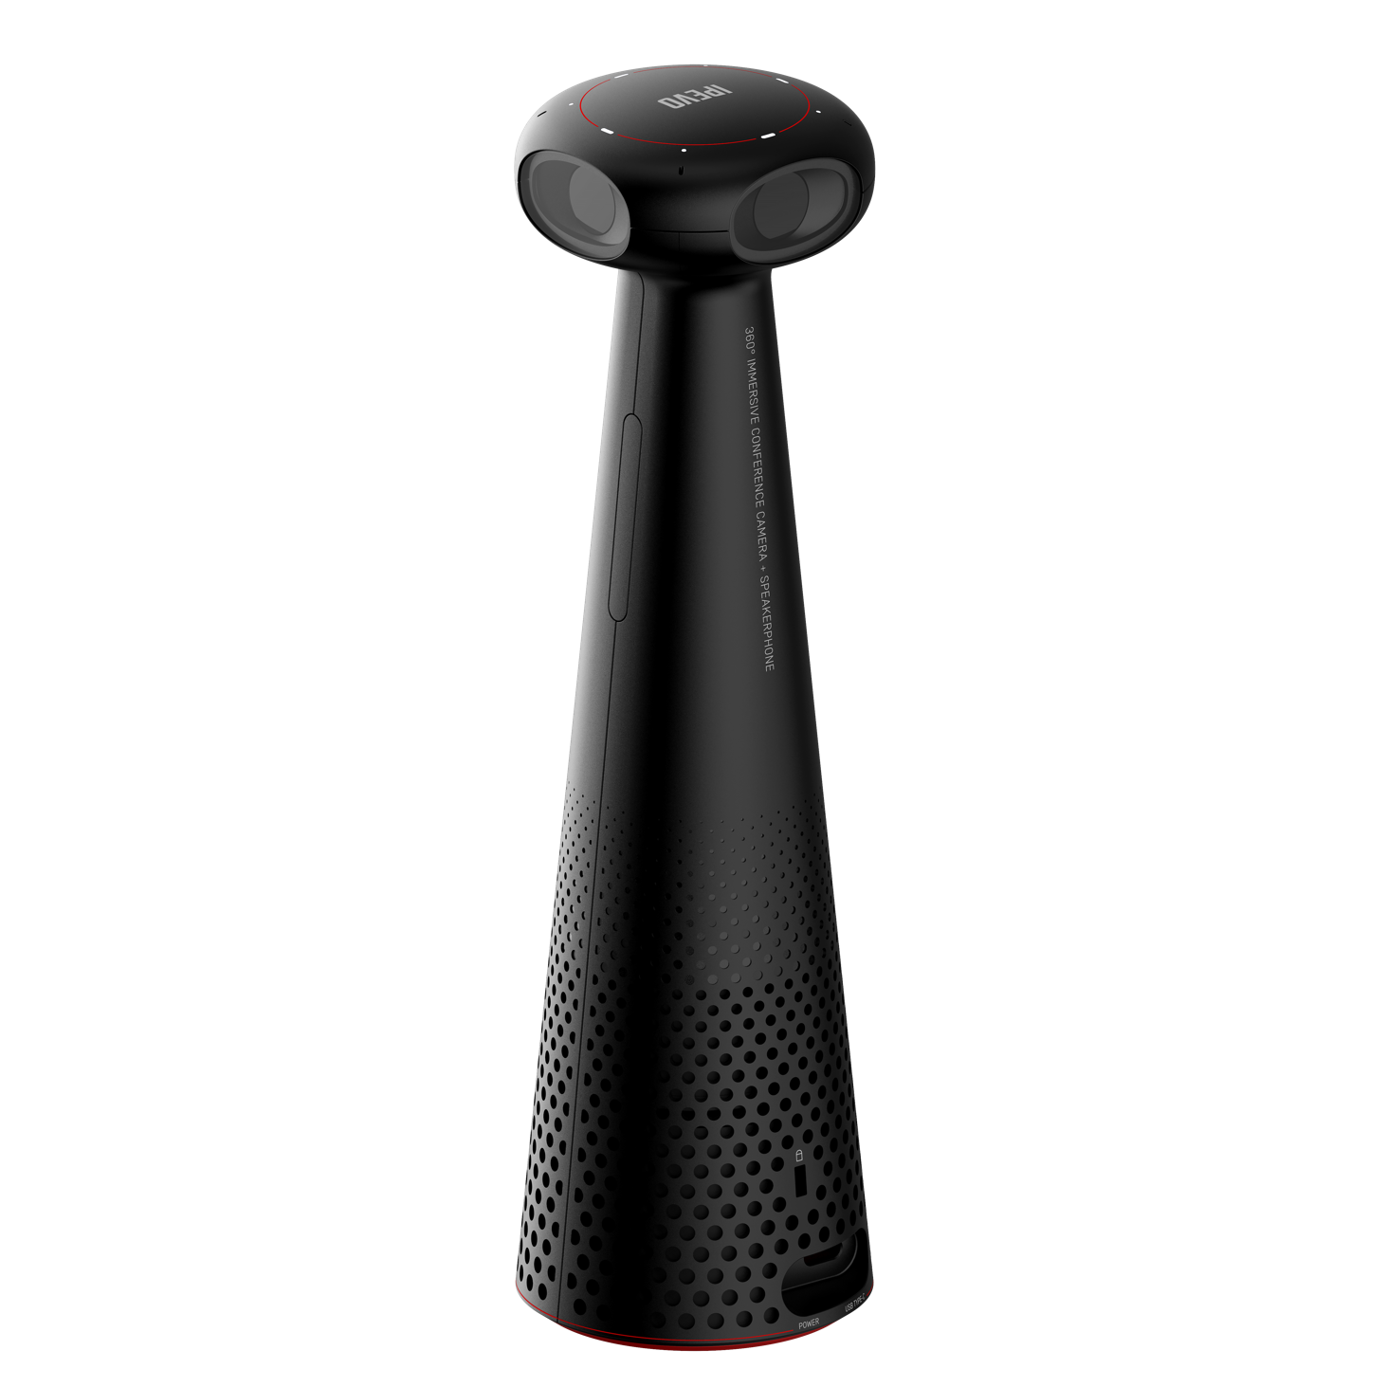
IPEVO TOTEM 360
Immersive Conferencing System
360° panoramic view with speakerphone for an immersive conference experience.
Focused meeting space with a smart AI audio and video algorithm that tracks speakers and presenters.
All-in-One design. It combines cameras, microphones and speakers into one compact and portable device.
3 collaboration modes: Presentation, Hybrid Learning, and Conference.
Ideal for multiple-people meetings
Place at the center of the conference table or in front of the presenter/audience.
Deploy at any small, medium, or large conference rooms and meeting spaces.

Slide 7
Thank You

